Slide 1

Presentation to Alaska Municipal League
November 19, 2015

Slide 2
Path to Fiscal Stability
“We expect that if lawmakers do not enact significant fiscal reforms to reduce the imbalance within the next year, the state’s rating could begin transitioning downward. The rating migration lower would likely persist and accelerate if lawmakers continued to fail to act…”
Alaska Rating Outlooks Revised To Negative Reflecting Its Large Structural Deficit
Standard and Poor’s Rating Service
August 18, 2015 Report

Slide 3
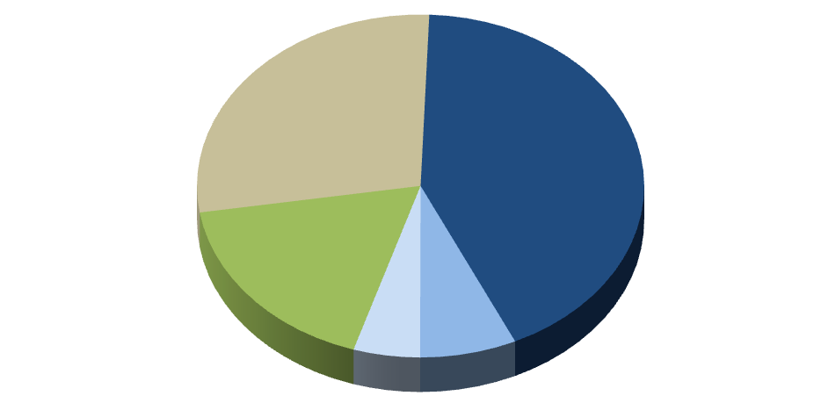
Fiscal Challenge
Federal Funds
$3.3 billion (27%)
Unrestricted
General Funds
$4.9 billion (41%)
Permanent Fund
Inflation Proofing
& Dividends
$2.3 billion (19%)
Designated General Funds
$914 million (8%)
Other State Funds
$630 million (5%)

Slide 4
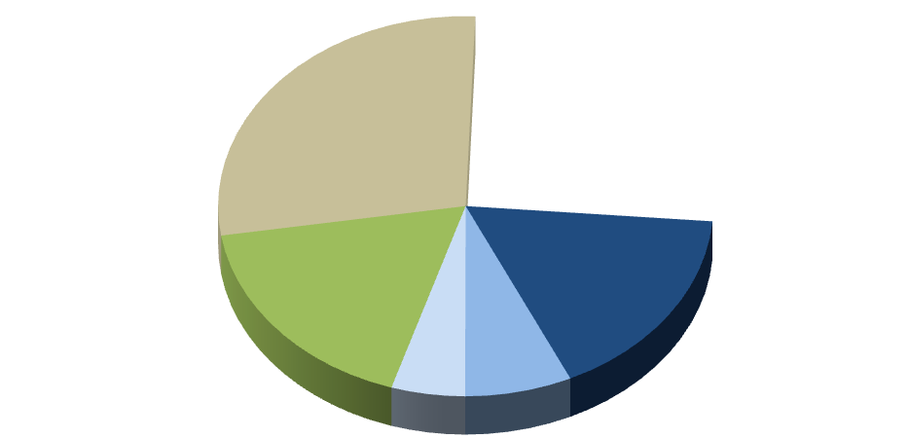
Fiscal Challenge
Federal Funds
$3.3 billion (27%)
Unrestricted
General Funds Gap
$2.7 billion (23%)
Unrestricted
General Funds
$2.2 billion (18%)
Permanent Fund
Inflation Proofing
& Dividends
$2.3 billion (19%)
Designated General Funds
$914 million (8%)
Other State Funds
$630 million (5%)

Slide 5
Fiscal Challenge

Slide 6
Fiscal Challenge

Slide 7
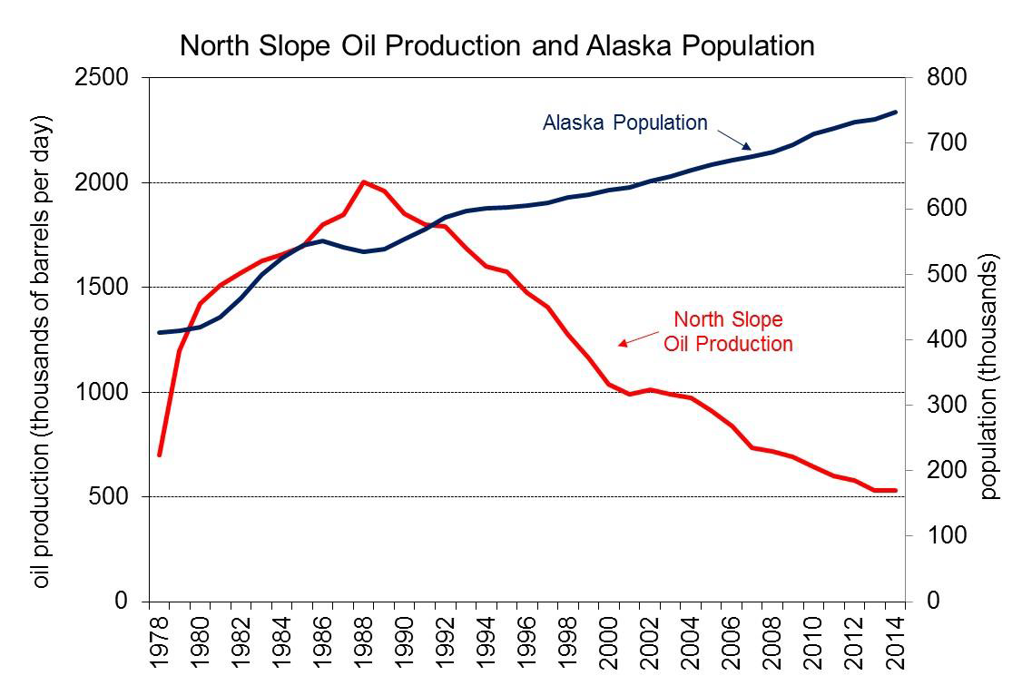
Fiscal Challenge

Slide 8
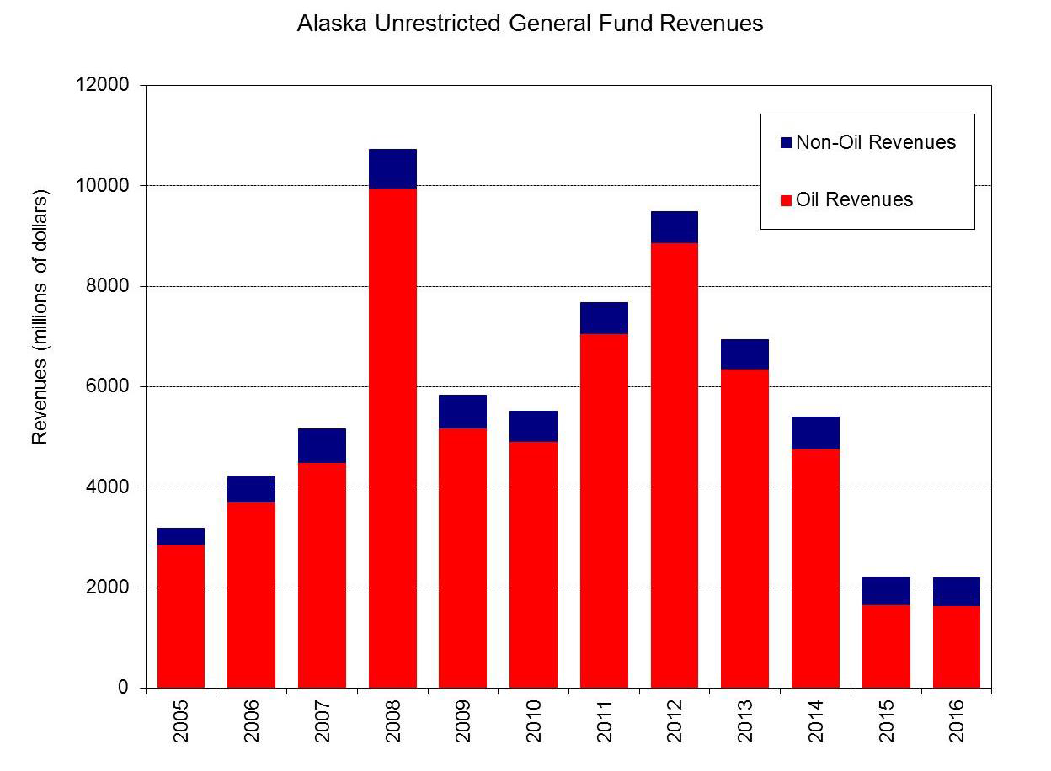
Fiscal Challenge

Slide 9
Fiscal Challenge
  Oil Price and Production is Unlikely to Save AK this time:
    Current price:
    $40/bbl and 500,000 bbls: 1.5B GF
    FY16 Forecast:
    $66/bbl: $2.2B GF
    Breakeven:
    $109/bbl and 500,000 bbls or
    $45/bbl and 1.6M bbls per day: $5B

Slide 10
Operating Budget Reductions
Agencies reductions FY15-FY16: $412M GF Cuts in 1 Year
Most significant % reductions
20-35%: Commerce, Military & Veterans Affairs, Labor & Workforce, Natural Resources, Governor’s Office
12-20%: Fish and Game, Revenue, Law, Administration, Transportation, Environmental Conservation
Most significant $ reductions
  Health and Social Services: $88 million (+ $1 million fuel cut)
  Transportation: $34 million (+ $15.5 million fuel cut)
  Corrections: $20 million (+ $1.8 million fuel cut)
  University of Alaska: $20 million (+ $4.5 million fuel cut)

Slide 11
Operating Budget Reductions
  Departments have been closing offices, a few examples :
    District Attorney’s Office in Barrow closed
    Public health center in Seward closed
    Vital Statistics office in Fairbanks closed
    Juvenile Probation office in Homer closed
    Trooper posts in Talkeetna and Yakutat closed
    State film promotion office in Anchorage was closed
Executive Agencies: 500 fewer full-time permanent employees - December 2014 to July 2015

Slide 12
Operating Budget Reductions
  Departments have been reducing or eliminating services, a few examples:
    Courts will be closed Friday afternoons
    Cold-case investigations were eliminated
    Inspections of public pools and spas were reduced
    Reduced Trooper presence at Arctic Man and similar events
    Reduced VPSO positions
    Reduced ferry service, some ferries will not be used next year
    Reduced snow removal and pothole repair

Slide 13
Operating Budget Reductions
  Departments have been reducing support for entities, a few examples:
    Eliminated state support of Alaska Aerospace Corporation
    Eliminated state support for AVTEC’s nursing programs
    Reduced grants to emergency communications systems
    Reduced state support for seafood and tourism marketing

Slide 14
Fiscal Challenge
Efficiency Initiatives:
Maximizing service delivery under the new budget reality
Cross Agency Efforts
  Smart justice reforms
  Unified state facilities management
  Lean/continuous process improvement management
  Shared services for functions such as procurement and travel
  Travel process redesign
  Statewide IT consolidation, call centers, disaster recovery, security, desktop support and data storage
  Re-examining charge back systems and streamlining internal billing
  Re-negotiating procurement and lease contract
  Centralize collection of fines, debts, and attachments
Intra-Agency efficiency efforts are on-going within each agency
Executive Agencies: 600 fewer full-time permanent employees - December 2014 to July 2015

Slide 15
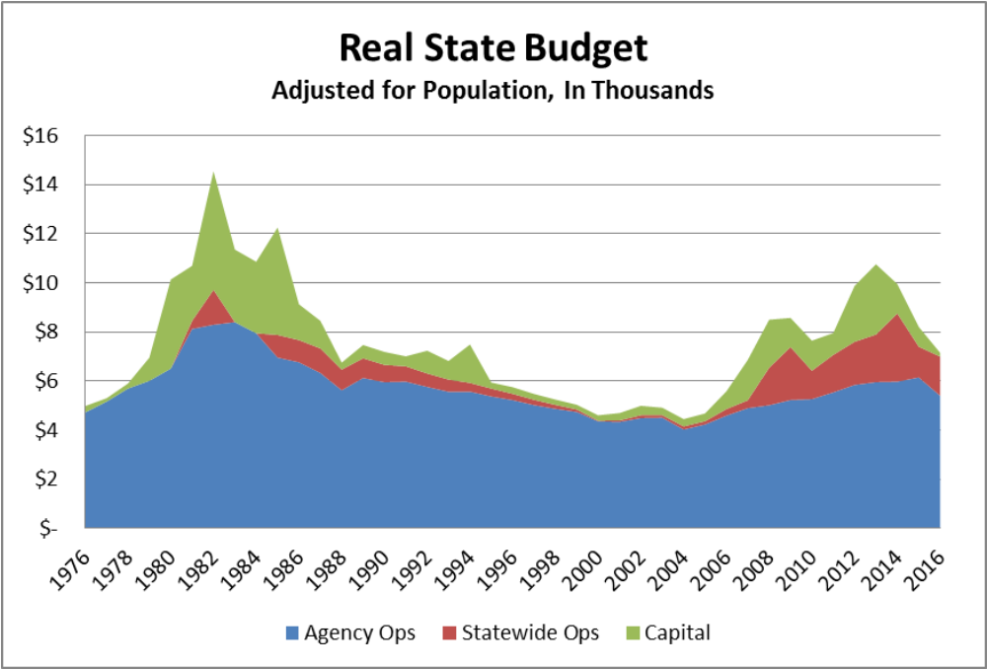
Fiscal Challenge
Adjusted for inflation and population, the current budget is lower than most years during the post-pipeline boom

Slide 16
State GF Budget Reductions - $3B from FY13-FY16
$3.0 billion transfer from CBR to retirement systems in FY2015

Slide 17
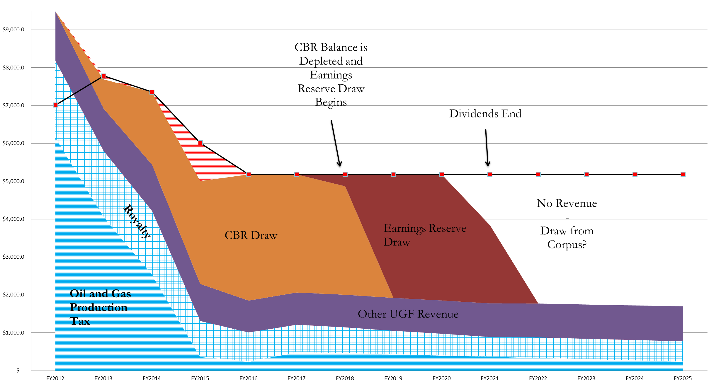
Current Path
Status Quo Fiscal Path

Slide 18
Opportunity
Current: Volatile Revenue and Corresponding Spending
Expected: Stable, Sustainable, Balanced Budget

Slide 19
Opportunity
Enhance permanent fund approach
preserves Alaska’s financial assets
(1) Maintain the value of assets – inflation proofing
(2) Grow the value of assets – investment and oil revenue
(3) Use investment income sustainably – formulaic draw
(4) Stabilize annual budget – delink from oil price
-- -- -- -- -- -- -- -- -- -- -- -- -- -- -- -- -- -- -- -- -- -- -- --
(5) Share resource wealth with Alaskans – dividend payout 50% of Royalty

Slide 20
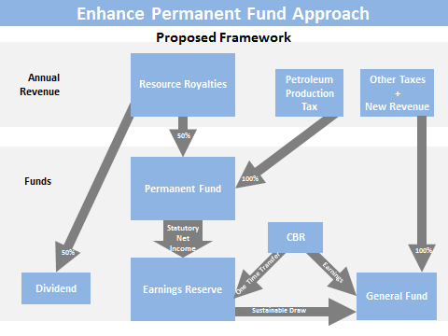
Opportunity

Slide 21
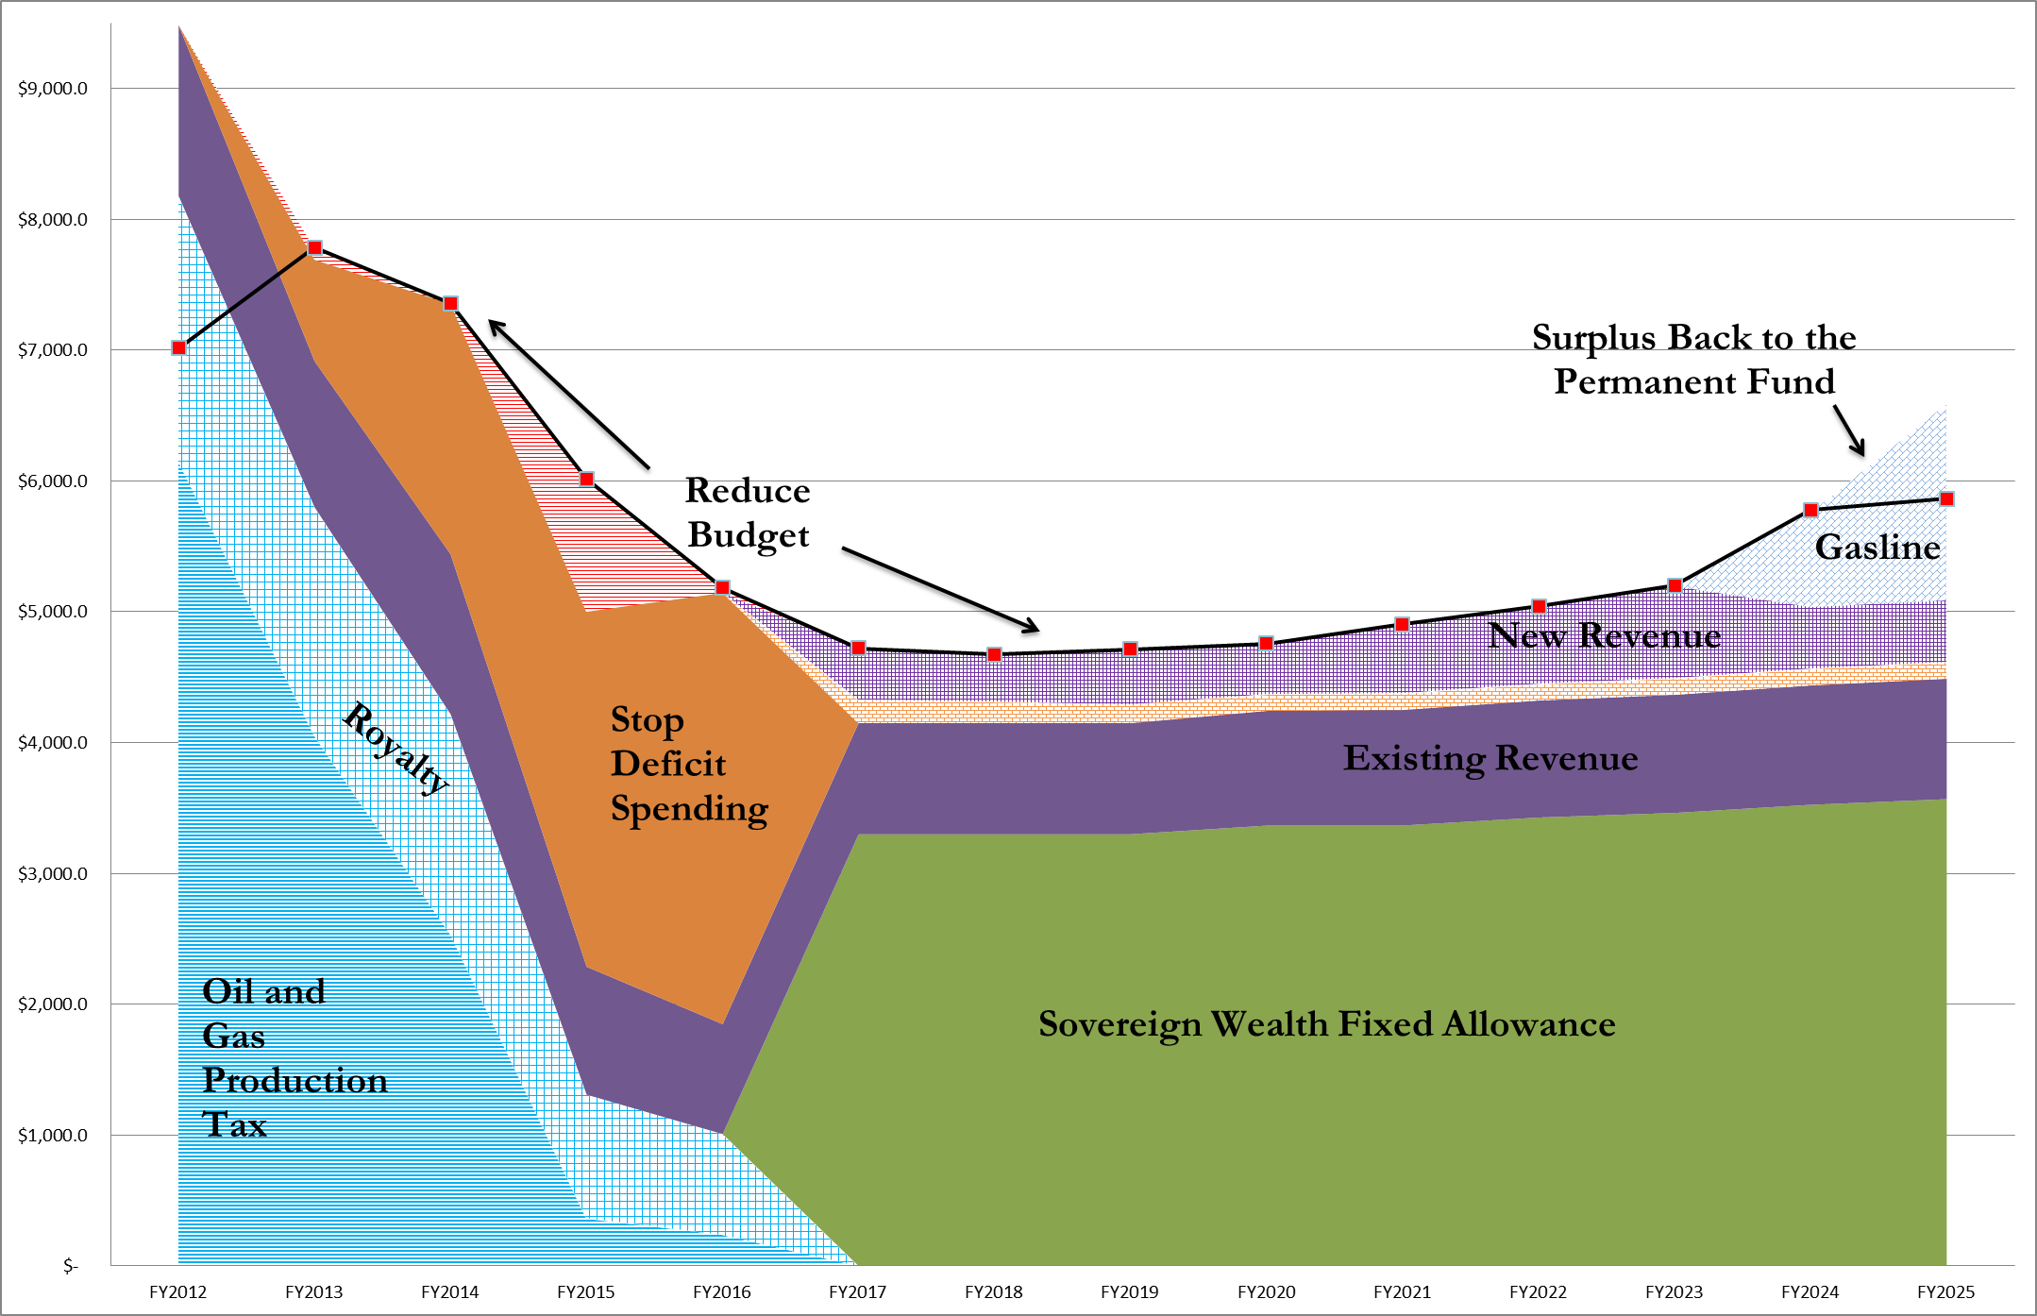
Opportunity
A Sustainable Budget - Fiscal Path

Slide 22
Path to Fiscal Stability
There are no easy answers to balancing a $3 billion annual deficit.
  Takes some combination of four things:
    Continued budgetary restraint
    Changes to oil and gas taxes/credits
    Strategic use of our existing assets
    Balanced suite of broad based and other taxes
Action must be taken this session!

Slide 23
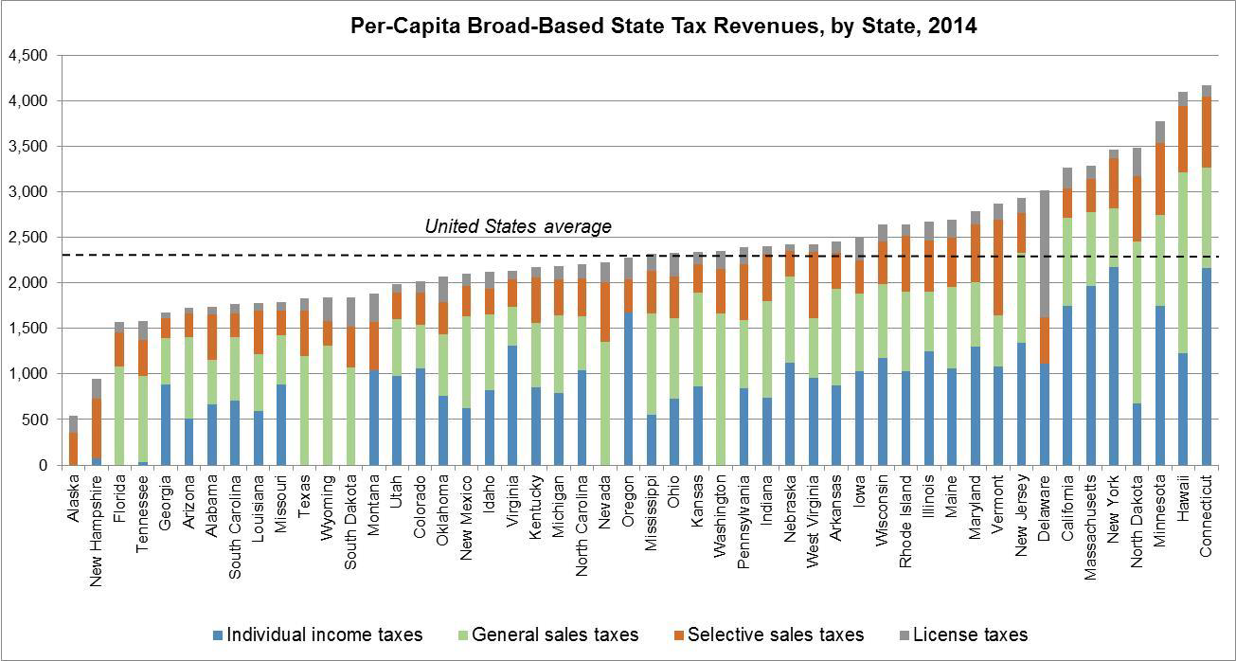
Opportunity

Slide 24
Current Path
Status Quo Fiscal Path

Slide 25
Opportunity
A Sustainable Budget - Fiscal Path

Slide 26
Further Conversations
Randall J Hoffbeck Pat Pitney
Commissioner, Department of Revenue Director, OMB
randall.hoffbeck@alaska.gov Pat.Pitney@alaska.gov
(907) 465-2300 (907) 465-4660

