Slide 1
MULTI-PURPOSE DOCK
GARY PAXTON INDUSTRIAL PARK | SITKA, ALASKA
Assembly Work Session
November 22, 2016

Slide 2
EFFORTS TO DATE
Sawmill Cove Waterfront Development Plan - 2002
Dock Funding Requests - CBS Legislative Priority since 2003
Funding provided via 2012 Statewide Transportation Funding Initiative - $7.5 Million
RFQ - Moffatt & Nichol – Preliminary Engineering
  Geotechnical Investigations, redirected options

Slide 3
EFFORTS TO DATE (continued)
R&M Feasibility Study on Repurposed (Concrete) Floats
Design-Build, Request for Proposals – Windward
Initial Proposals Received – All Exceeded budget
Best Apparent Value Proposals Received
Multiple GPIP Board meetings to select best value proposer – Turnagain Marine Construction

Slide 4
WHY DESIGN-BUILD?
Competitive, Innovative Solutions with
Committed Pricing by Qualified Teams
SINGLE ENTITY:
fully responsible for all work
(design, permit, procure, construct, inspect, management)
BENEFITS:
Design = Competitive
Constructability & Efficiency
Less Risk to Owner
Increased Quality – Ownership
In-Turn: throughout project, Owner focuses on “big picture” scope and preferences. Not detailed oversight.

Slide 5
Facility Priorities – Request for Proposals
  Accommodate barges, including the handling and stacking of 40-foot, loaded containers (total of approximately 300,000 lbs) with industry standard equipment.
  Accommodate a vessel with 40-foot draft at a -5’ tide with 5’ of under-keel clearance.
  No less than 100’ x 50’ dock surface area. More area is highly desirable; if not feasibly at this time, the ability to reasonably expand the surface area.
  Provide commercial fishing industry practical moorage and vehicle access to vessels.
  The ability to make reasonable upgrades to accommodate expansion for large vessels that may benefit from a deep-water port. An example of “reasonable” may include, but is not limited to, the future addition of dolphins or floating structures and other structural upgrades. The list of future potential users remains: passenger ships, cargo, containerships, bulk water, and fish processing/tenders.
  Floating structure is preferred but not required.

Slide 6
Final Best Value Determination
Turnagain Marine Construction Corporation – 1st
Pacific Pile & Marine, LP – 2nd
Heko Services, Inc. – 3rd

Slide 7
GPIP Multi-Purpose Dock Features – Best Value
$6.8 Million
250’ x 74’ floating repurposed ABS certified, double-hull steel barge
  New exterior coating and cathodic protection
Minimum 14’ wide drive down ramp (24’ wide ramp being evaluated)
Adjustable freeboard heights between 4’ – 15’
Deck strength to meet cargo shippers needs
Positioned in 50’ of water for potential future expansion
High mast lighting, 120V receptacles, heavy shore power (3 phase)
Fenders, fire suppression, & safety equipment
12’ x 120’ small vessel float
50-year service life (minimal maintenance)

Slide 8
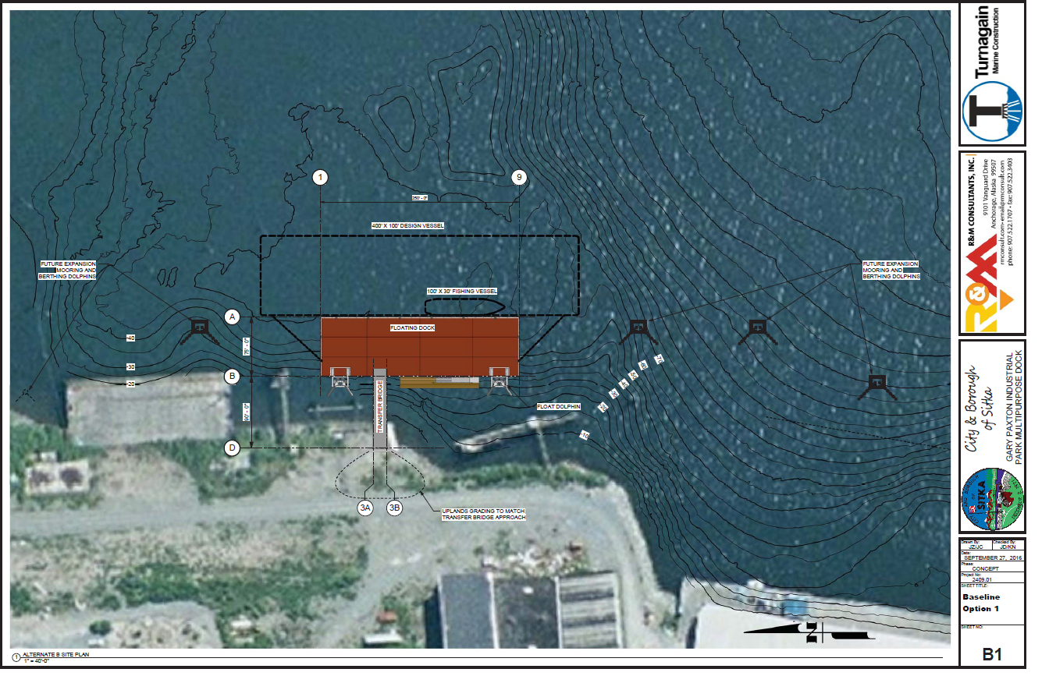

Slide 9
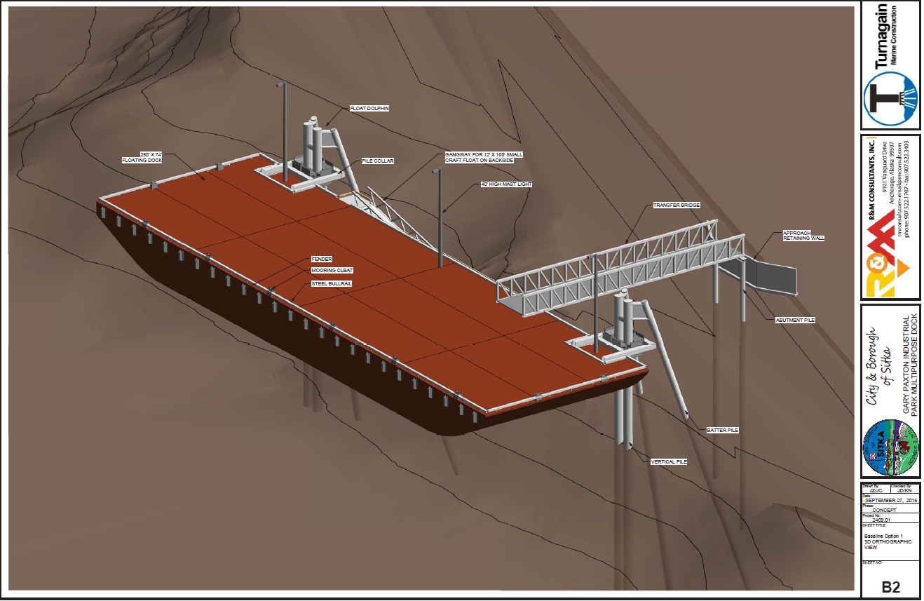

Slide 10
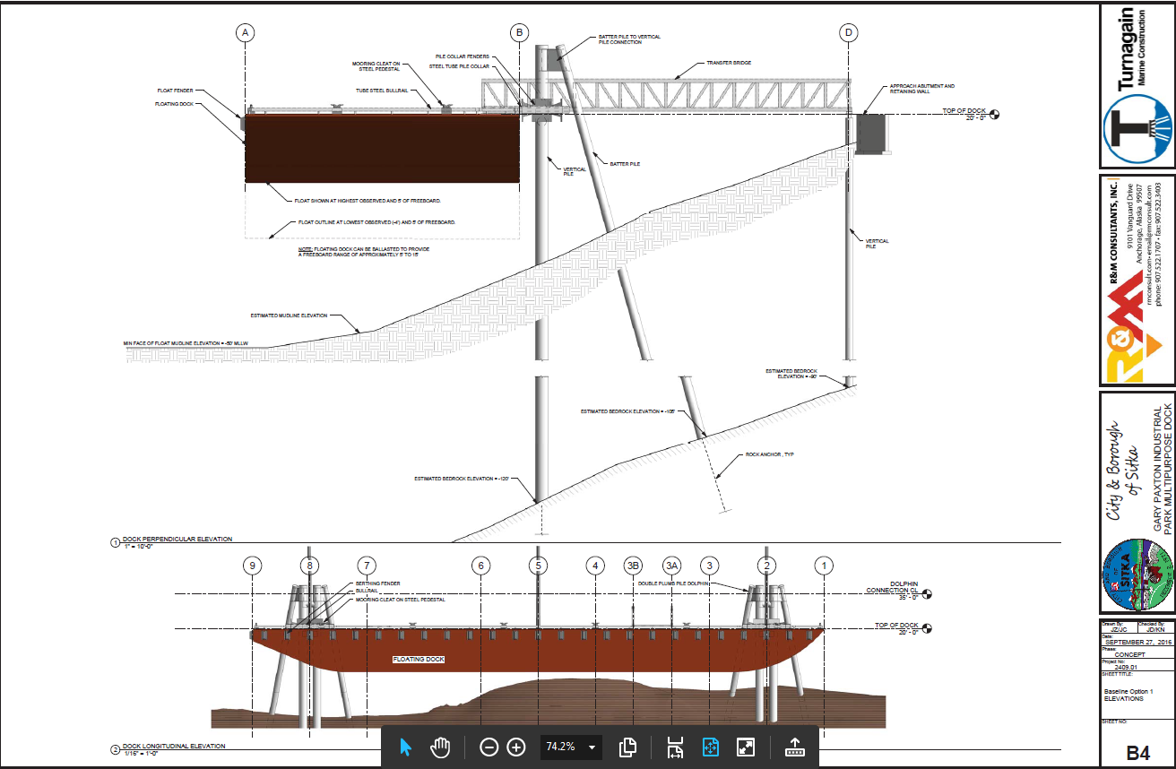

Slide 11
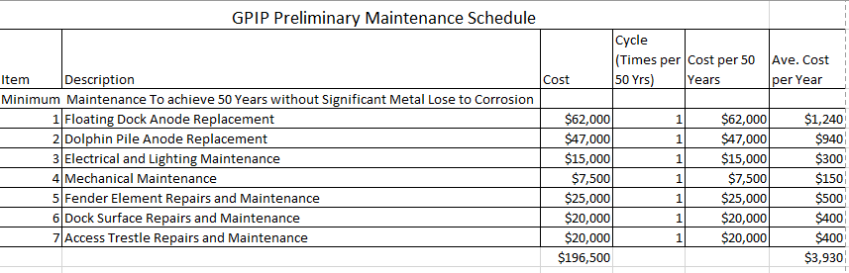
Estimated Dock Maintenance Costs
*A detailed Operations and Maintenance Manual will be developed during detailed design to assist CBS with implementation of a long term maintenance program.

Slide 12
GPIP Multi-Purpose Dock Project Timeline
Design November 2016 – April 2017
Permitting November 2016 – April 2017
Material Procurement/Fabrication November 2016 – April 2017
Construction June 2017 – August 2017
Project Closeout Fall 2017

Slide 13
GPIP Multi-Purpose Dock Project Budget
FY13 Grant Funding $7,500,000
*Contingency (GPIP Ent Fund & Bulk Water Fund) $ 250,000
Total Project Funding $7,750,000
Expenses to date $ 488,238
Design/Build Contract (Turnagain Marine) $6,800,000
Estimated costs to complete $ 180,000
Estimated Total Project Expenses $7,468,238
Contingency Funds $ 281,762
*Agenda Item G, Ord 16-42

Slide 14
GPIP Multi-Purpose Dock Operational Plan
A draft tariff of costs and regulations to use the dock have been developed for future discussion and implementation.
  The GPIP Director has held informal conversations with multiple businesses on potential uses of the dock for moving freight, vessel moorage, and in water vessel work.
An Operational Management Plan for the dock has not been fully implemented at this time.
  The GPIP Director and CBS Harbor Master have discussed and will be finalizing a plan to manage users of the facility.

Slide 15
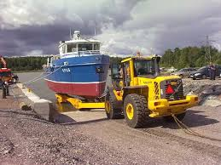

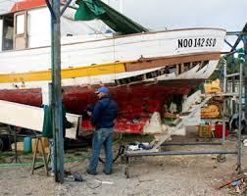
Economic Benefits of a
Multi-Purpose Dock
Creates an anchor for marine service industries at GPIP
Supports and draws the fishing fleet to Sitka
Allows for new businesses to take hold, creating new jobs
Provides additional location for freight deliveries
Makes GPIP a true water accessible park

Slide 16
THANK YOU
Gary Paxton Industrial Park Multi-Purpose Dock
Opening up opportunities for the marine services industry & future development of the Park

