Slide 1


Strategic, Financial, and Operational Assessment
Report Date: July 13, 2017
Eric Shell, MBA, CPA
Jonathan Pantenburg, MHA

Slide 2
Overview
  Sitka Community Hospital (SCH) is an 12-bed Critical Access Hospital (CAH) with an attached 15-bed skilled nursing facility, providing acute care, long-term care, primary care, emergency medicine, surgery, and related outpatient ancillary services to the residents of Sitka, Alaska
    SCH is a municipal general hospital, governed by a Board of Directors appointed by the Assembly of the City and Borough of Sitka, AK, and is a component unit of the City and Borough
  In 2016, SCH and the Southeast Regional Health Consortium (SEARHC), a non-profit tribal health consortium of 18 Native communities, looked to establish a long-term vision for service delivery within the region
    As part of the process, an independent consultant was engaged to evaluate options for improved alignment
      Options evaluated included status quo, joint venture, and merger
      Consultant recommended merger as the preferred option for alignment and recommended SEARHC submit a merger proposal for the Sitka Assembly to review
        Merger proposal was submitted by SEARHC to city Assembly in May 2017
  SCH engaged Stroudwater to evaluate market, operational, and financial opportunities to solidify the position of the hospital within the region and assess the ability of SCH to sustain operations under the current organizational structure, with the potential for a more improved collaboration between SCH and SEARHC
    In addition, Stroudwater created a 10-year financial proforma that approximates the financial position of the organization based on revenue and expense fluctuations
    SEARHC has no obligation to collaborate and thus collaborative initiatives between SEARHC and SCH must be mutually beneficial

Slide 3
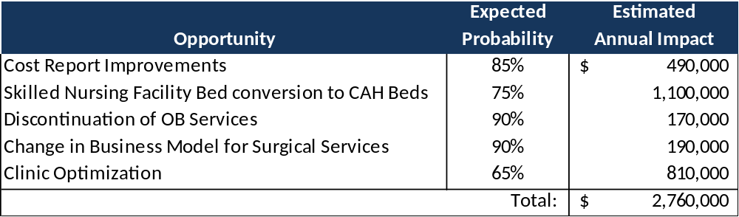
Overview
  Based upon our analysis of the data provided and financial modeling we performed, SCH is in a position to generate positive operating margin and improved financial liquidity and to fund ongoing capital requirements through the following opportunities:
  Stroudwater also modeled the following for capital projects at SCH:
    Transition to the Cerner EHR in FY19
    $550K per year for facility repairs, renovations, and equipment
  Implementing all of the recommendations detailed in the financial modeling section of this report would improve both the net income and cash position by $2.4M per year on average or nearly $24M over the 10-year measured period which would strengthen financial performance, provide capital for reinvestment, and improve financial independence over the long term
    Please note that this report was based on our determination of the highest value opportunities for SCH as identified during the site visit and that additional opportunities may exist for performance improvement

Slide 4
Engagement Purpose & Methodology
Overview
  SCH engaged Stroudwater to complete a strategic, financial, and operational assessment (SFOA) with financial modeling for the purposes of:
      Answering financial, operational, and industry-specific questions presented by the Board and administration
      Helping to identify top opportunities that will result in improved financial and operating performance
      Projecting future financial performance based on various assumptions including, but not limited to, service expansion and or reduction, service delivery optimization, and organizational optimization
      Best-positioning SCH for success in the rapidly evolving healthcare market, including new payment and delivery care models, and to promote value within a population health management system
Purpose
    To identify and financially model performance-improvement opportunities that will result in increased financial stability, with areas to address including:
      Evaluation of historic/potential demand for clinical services
      Identification of opportunities to appropriately address clinical service line gaps
      Reimbursement and cash flow with emphasis on selected service lines
      Hospital expense analysis
      Organizational architecture and management principles
      Strategic direction

Slide 5
Engagement Purpose & Methodology
Methodology
    Gather and review pertinent market, clinical service line, and financial data, including:
      Detailed inpatient utilization and outpatient data for all revenue centers
      Clinic charges and visits by provider
      Recently-filed cost reports
      Audited financial statements and financial and utilization (inpatient and outpatient) projections
    Conduct an intensive two-day site visit
      Meet with Board members to engage on strategic direction
      Interview with CEO, CFO, COO, CNO, Chief of Medical Staff, senior leadership team members, clinical operational staff, and selected department managers
      Preview findings and preliminary recommendations prior to site visit departure
    Complete a financial assessment for SCH
    Prepare final report and recommendations
    Action Planning
    Follow up as required

Slide 6
FINANCIAL ASSESSMENT

Slide 7
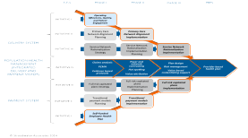
Financial Model
Overview
    In order to project the future financial position of SCH, Stroudwater created a 10-year financial proforma which approximates the financial position of the organization based on revenue and expense fluctuations
      Stroudwater used FY16 as the base year and FY17 – FY26 were forecast years
        Since FY17 ended on June 30, 2017, assumptions and modeling will begin in FY18
  As part of the financial model, Stroudwater assessed the impact of each of the following scenarios with a “status quo” scenario at SCH:
    Cost Report improvements
    Long Term Care Bed Conversion to CAH Beds
    Elimination of OB program
    Reducing Surgery from 24/7 to scheduled surgeries M – F
    Clinic Optimization
      Volume Increases
      Addition of 340B

Slide 8
Financial Model
Assumptions
  Stroudwater applied the following assumptions across all models to account for revenue and expense variation
    Revenue Assumptions:
      Prices increased by 2% per year starting in FY18
      Bad Debt set at 2.25% of Gross Charges each year
      Reimbursements:
        Medicare reimbursements driven by cost-based reimbursement
        Medicaid cost-based every 4th year, then set increases each other year at 2%
        All other payors set at 91.0% of charge in FY16, then increased 2% each year thereafter
          Professional fees reimbursement set at 55% of charge, then increased 2% thereafter
      Volumes remained constant from FY17 through FY26 unless stated otherwise in one of the subsequent scenarios
        Actual volume fluctuations up or down will impact the financial performance of SCH
      Other Operating Revenue:
        Set at a fixed $399K per year
      Non-Operating Revenue:
        Tobacco Tax remained at $680k from FY17 through FY26
        Sitka Support of Fixed Assets remained at $153K from FY17 through FY26
        Interest Income set at 0.72% of the cash balance

Slide 9
Financial Model
Assumptions (continued)
  Stroudwater applied the following assumptions across all models (continued)
    Expense Assumptions:
      The following expenses were increased 2% each year from FY18 – FY26
        Salaries & Wages
        Other Miscellaneous
      The following expenses were increased 3% each year from FY18 – FY26
        Supplies
        Professional Fees
      Benefit expense set at 52% of Salaries and Wages from FY18 – FY26 based on the following:
        PERS benefit: 22% per year
        Other benefits: 30% per year (FICA, SUTA, FUTA, Medical, etc.)
      Staffing full time equivalents (FTEs) remained constant unless specifically addressed in a subsequent scenario

Slide 10
Financial Model
Assumptions (continued)
  Stroudwater applied the following assumptions across all models (continued)
    Other Assumptions:
      Stroudwater assumed the transition to Cerner for an EHR starting in FY19 at an initial capital cost of $2.9M at 0% interest over 7 years with $600K due in FY19 and $385K due each year for the following 6 years
        Recurring operating cost factored at $400K per year starting in FY20
      Capital Projects:
        Stroudwater assumed $550K in annual capital expenditures
      The following table highlights facility and equipment purchases from FY18 through FY26

Slide 11
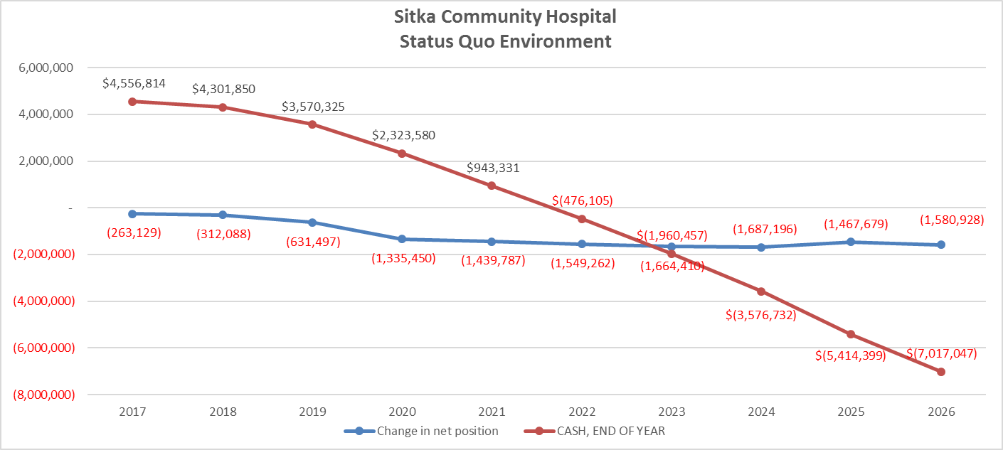
Scenario: Status Quo
Scenario: Status Quo
  The following chart presents the projected annual net income of SCH and the year end cash balance under a “status quo” environment
    Based on the projected operating statement, SCH net income would decrease from ($263K) in FY17 to ($1.6M) in FY26 and the cash balance would decrease from $4.6M in FY17 to ($7.0M) in FY26 due to the continued increase in operating expenses

Slide 12
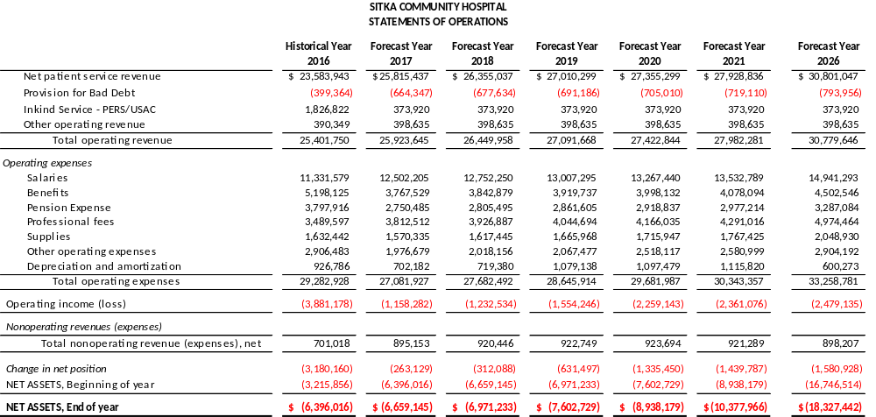
Scenario: Status Quo
Scenario: Status Quo (continued)
  The following table presents the projected operating statement of SCH under a “status quo” environment
    Based on the projected operating statement, SCH net income would decrease from ($263K) in FY17 to ($1.6M) in FY26 due to the continued increase in operating expenses

Slide 13
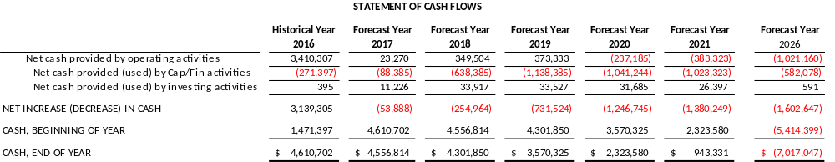
Scenario: Status Quo
Scenario: Status Quo (continued)
  The following table presents the cash position of SCH under a “status quo” environment
    Based on the continued decline in net income, the SCH cash position would decline from $4.6M in FY17 to ($7.0M) in FY26
  Conclusion:
    Unless SCH makes changes to the current operational environment, SCH would be dependent on external resources to sustain operations at the hospital

Slide 14
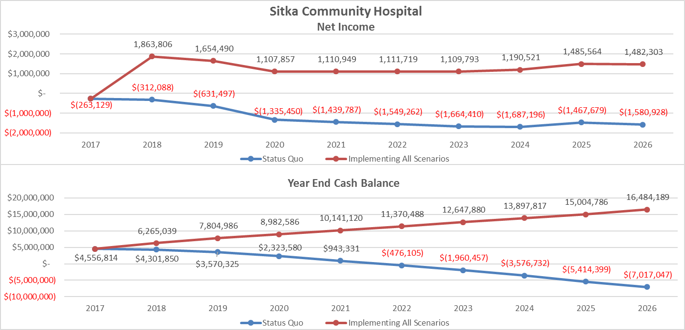
Financial Modeling Summary
Implementation of all Financial Modeling Recommendations
  Implementing all of the recommendations detailed in the financial modeling section of this report would improve both the net income and cash position by nearly $24M over the 10-year measured period as referenced below (see Appendix VI for detailed statements):
    The following chart present both a comparative operating statement and cash position for SCH should the organization implement all suggested recommendations:

Slide 15
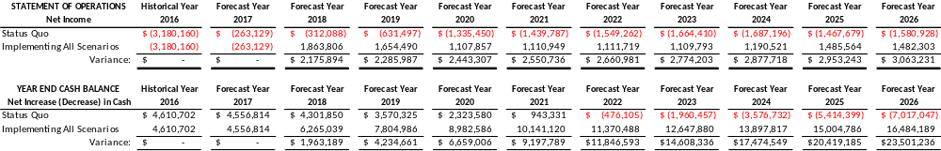
Financial Modeling Summary
Implementation of all Financial Modeling Recommendations
  The following tables present both a comparative operating statement and cash position for SCH should the organization implement all suggested recommendations:
  Recommendations:
    SCH should implement the suggested changes in order to improve the financial performance of the organization and remove the dependency of SCH on external funds to sustain operations

Slide 16

Financial Modeling Summary
Implementation of all Financial Modeling Recommendations except conversion of LTC Beds to CAH Beds
  The following tables present both a comparative operating statement and cash position for SCH should the organization implement all suggested recommendations except the conversion of LTC beds to CAH beds:
    Implementing all of the recommendations detailed in the financial modeling section of this report would improve both the net income and cash position by nearly $16M over the 10-year measured period as referenced below (see Appendix VII for detailed statements):
  Recommendations:
    SCH should implement the suggested changes in order to improve the financial performance of the organization and remove the dependency of SCH on external funds to sustain operations

Slide 17
APPENDIX

Slide 18
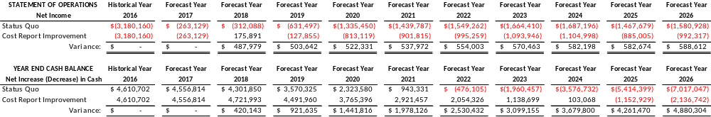
Scenario: Cost Report Improvements
Scenario: Cost Report Improvements
  Stroudwater modeled operational changes to reflect best practice:
    ED Physician Stand-by Time: $670K added back as an allowable expense in FY18 to reflect 20 minutes of professional time per ED visit
    Added back in $150K in physician cost to A&G to factor administrative work done by physicians
    Directly allocated $110K in Ward Clerk wages to the Med/Surg Unit
    Increased Clinic Technical charges in FY18 by $750K to reflect technical charge of $75 per visit
  Implementing the cost report improvements would improve both the net income and the cash position by $4.9M over the measured period as referenced below (see Appendix I for detailed statements):
  Recommendations:
    Implement the cost report improvements mentioned above to leverage higher reimbursements from cost based payors
      SCH must work with the cost report preparer to ensure accurate inclusion of expenses in subsequent cost report years

Slide 19
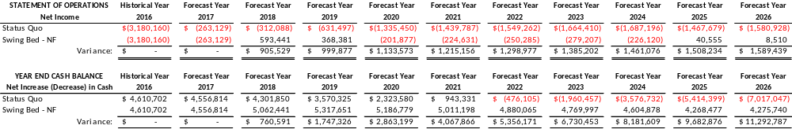
Scenario: LTC Bed Conversion to CAH Beds
Scenario: LTC Bed Conversion to CAH Beds
  Stroudwater modeled operational changes to reflect best practice:
    SCH would designate the current LTC beds as CAH beds and use NF bed designation to more effectively leverage cost-based reimbursement
      Swing Bed – NF reimbursements based on current SNF rate of $957 per day
        The rate was increased by 2% each year, then reset every 4th year based on a cost-based rate
      Transitioning the beds to Swing Bed – NF will also remove the annual Medicare survey associated with LTC Facilities
  Changing the bed designation from LTC to CAH beds would improve both the net income and cash position by $11M over the measured period as referenced below (see Appendix II for detailed statements):
  Recommendations:
    Pursue changing the LTC beds to Swing Bed to leverage more favorable reimbursement from Medicare for other cost-based days

Slide 20
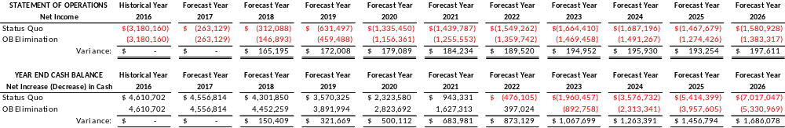
Scenario: Elimination of OB Program
Scenario: Elimination of OB Program
  Stroudwater modeled operational changes based on best practice:
    SCH would eliminate the OB program based on volumes within the department, overall cost, and the ability of staff to maintain core competencies based on volumes within the department
      Stroudwater removed both the revenue and expenses generated by the program
      Since MEH also operates an OB program, Sitka residents will still be able to receive services within the community
  Eliminating the OB program would improve both the net income and cash position by $1.7M over the measured period as referenced below (see Appendix III for detailed statements):
  Recommendations:
    SCH should consider eliminating the OB program based on the revenue and costs associated with maintaining the program

Slide 21
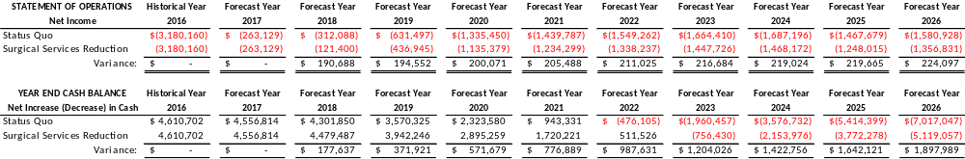
Scenario: Reduction in Surgical Services
Scenario: Reduction in Surgical Services
  Stroudwater modeled operational changes based on best practice:
    SCH would reduce surgical services from the current 24/7 to scheduled, daytime surgeries, M – F
      Since most of the surgeries performed at SCH are Endoscopes, SCH should not realize a reduction in surgical revenue
        Since MEH also operates a full surgical program, community members can receive emergent surgical services at that hospital
      Stroudwater reduced surgical costs by $250K which takes into account the reduction in physician, nursing, and support staff from a 24/7 schedule to a 40-hour work week consisting of scheduled daytime surgeries
  Implementing the reduction in surgical services would improve both the net income and cash position by $1.9M over the measured period as referenced below (see Appendix IV for detailed statements):
  Recommendations:
    SCH should change the surgical program from the current 24/7 schedule to scheduled surgeries M – F based on the services sought at SCH

Slide 22
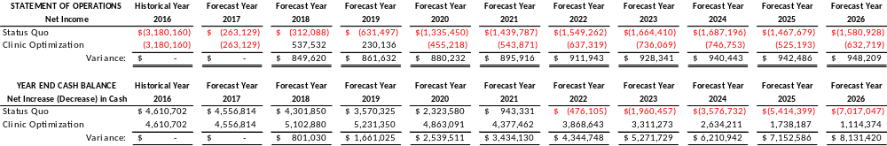
Scenario: Clinic Optimization
Scenario: Clinic Optimization
  Stroudwater modeled operational changes based on best practice:
    Based on the complement of providers and hours of operation, SCH can increase the number of annual visits by 2,500 through marketing and delivery optimization at no cost increase
      Stroudwater increased both the Professional Fee and technical charge revenue by $75 each to account for volume growth
    As a provider-based clinic, SCH should implement the 340B program to realize the net financial benefit of the program
      SCH would realize a net financial benefit of roughly $500K based on increased projected visits
  Implementing clinic optimization strategies would improve both the net income and cash position by $8.1M over the measured period as referenced below (see Appendix V for detailed statements):
  Recommendations:
    SCH should implement the 340B program to realize the net financial benefit of the program
    SCH should work to optimize the clinic and increase marketing efforts to improve the number of annual visits at the clinic

Slide 23
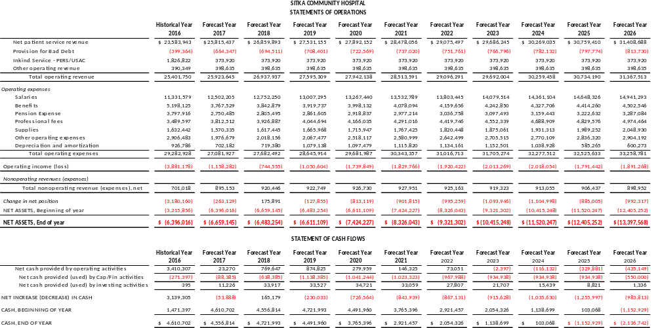
Appendix I
Scenario: Cost Report Improvements

Slide 24
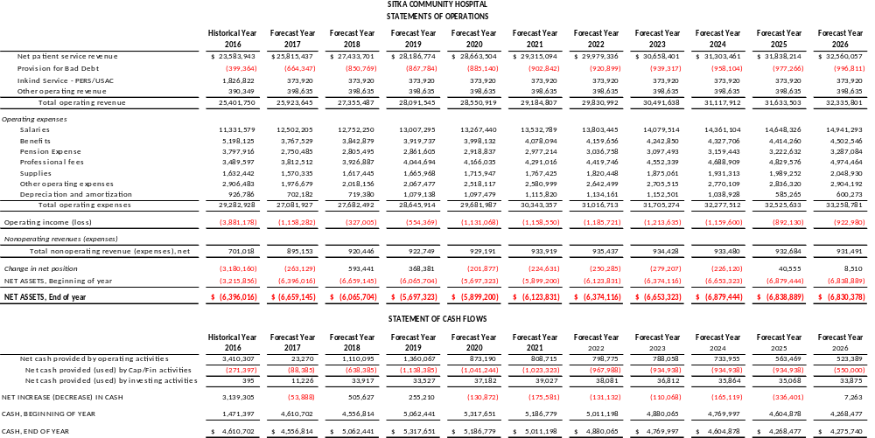
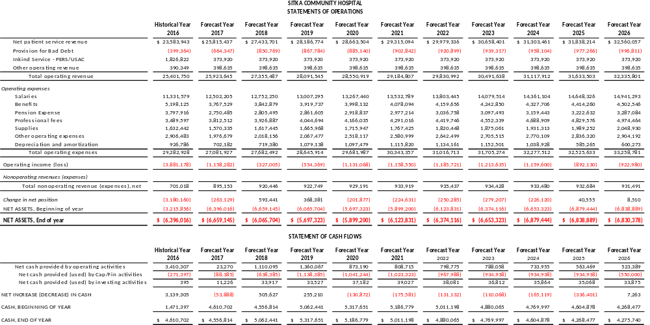
Appendix II
Scenario: Skilled Nursing Facility to Swing Bed - NF

Slide 25
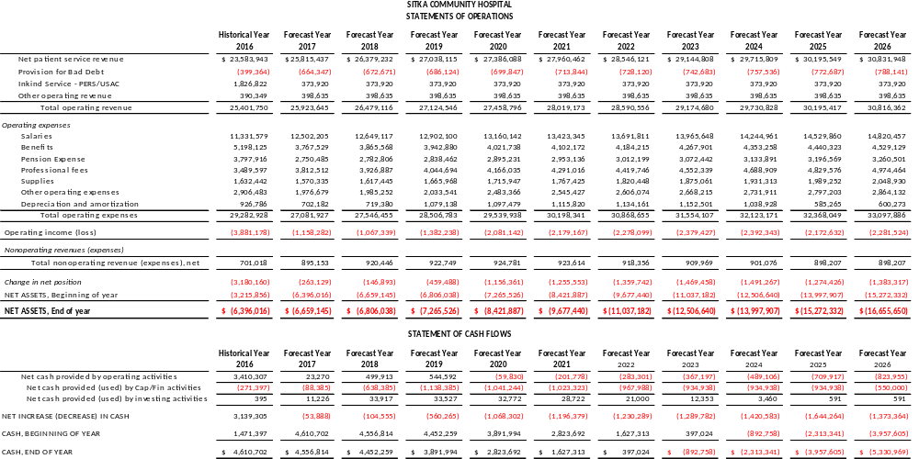
Appendix III
Scenario: Elimination of OB Program

Slide 26

Appendix IV
Scenario: Reduction in Surgical Services

Slide 27
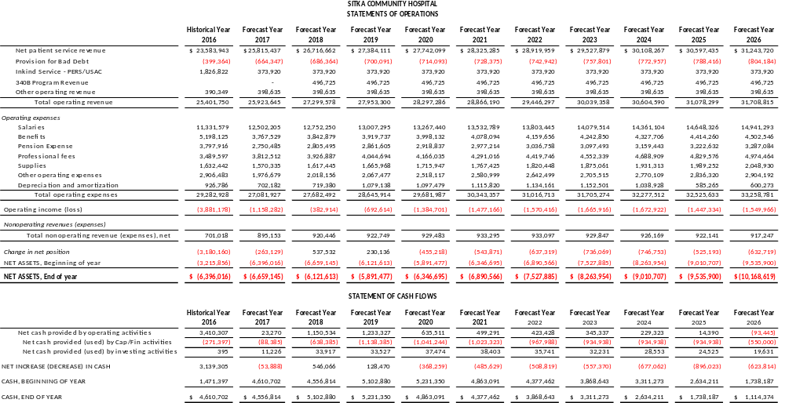
Appendix V
Scenario: Clinical Optimization

Slide 28
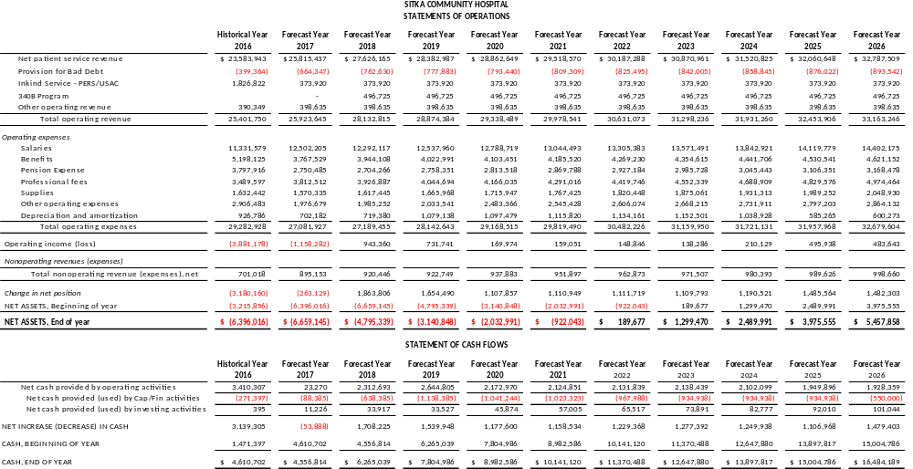
Appendix VI
Scenario: Consolidation of All Scenarios

Slide 29
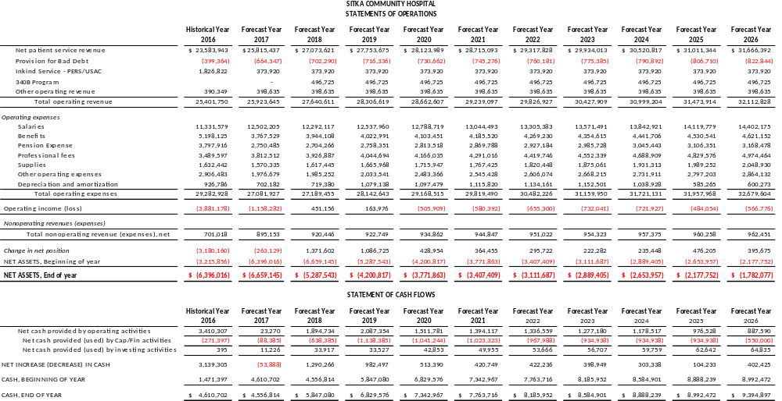
Appendix VII
Scenario: Consolidation of All Scenarios Except LTC Conversion to CAH Beds

Slide 30
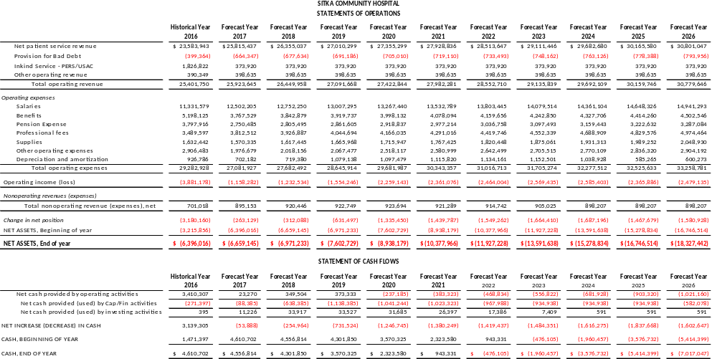
Appendix VIII
Scenario: Status Quo

Slide 31

1685 Congress St. Suite 202
Portland, Maine 04102
(207) 221-8250
www.stroudwater.com

