Slide 1

Budget Worksession III
April 12, 2019
DISCOVER | NURTURE | INSPIRE

Slide 2
www.sitkaschools.org
Latest News: FY20 Budget Development

Slide 3
Reductions Due to Lower Enrollment
Department/School | FTE | Position | Type of Reduction | Savings
Baranof | 1 | 1st Grade Teacher Position | Retirement | $100,000
Keet Gooshi Heen | 1 | 2nd-5th Grade Teacher Position | Reduction in Force | $100,000
Keet Gooshi Heen | 1 | 2nd-5th Grade Teacher Position | Reduction in Force | $100,000
Rationale: 1st and 2nd-5th Grade Teacher Positions: Fewer students are enrolling in school than in previous years, and the impact is seen mostly in the elementary grades
Note: In order to use Title II funds to support class size reduction, as we have been for decades, we need to have one grade level with no more than 18 students per class (on average), and kindergarten was selected because we historically keep kindergarten classes as small as possible

Slide 4
FY20 Preliminary Budget Deficit
 | Running Total
Preliminary FY20 Budget Deficit* | [$1,689,103]
Unassigned Fund Balance | $205,334
Non-Personnel Efficiencies [Note: Added a reduction of $5,000 from IT] | $33,750
Elimination of 1 Special Education Teacher | $100,000
Deficit | [$1,350,019]
*Preliminary FY20 Budget Deficit includes:
  A reduction of 3 Elementary Teachers due to lower student enrollment
  Assumes a 12% insurance premium increase
  Assumes flat funding from the City
  Assumes full funding of Base Student Allocation but no appropriation from 1 time $30 million [$309,000]

Slide 5
FY20 Preliminary Budget Deficit Options
Preliminary FY20 Budget Deficit [$1,350,019]
 | Running Total
Community Schools RFP @ $0 Contribution | $100,000
Partner with SFAC and City on the PAC | $160,000
No Self-Funded Insurance and 6% Renewal Rate | $200,000
Lower Utilities/Subs in Current Year that Budgeted* | $50,000
Deficit | [$840,019]
*Note: Data will be updated through March at the Final Budget Hearing

Slide 6
FY20 Personnel Reduction Recommendation
in Priority Order

Slide 7
Overview of Revenues
FY16-Fy20 =
$1.1 million less
 | 2015-16/FY16 | 2016-17/FY17 | 2017-18/FY18 | 2018-19/FY19 | 2019-20/FY20
Sitka Schools Audit/Budget | $20,258,466 | $19,855,532 | $19,657,832 | $19,781,136 | $19,162,085
City - Instructional | $6,283,762 | $6,183,762 | $6,144,019 | $6,644,941 | $6,644,941
Other Local | $285,446 | $195,021 | $166,949 | $113,160 | $113,160
State | $13,384,820 | $13,416,216 | $12,998,280 | $12,718,035 | $12,323,983
Federal | $304,438 | $60,533 | $348,584 | $305,000 | $80,000
City - Non-Instructional | $433,759 | $433,759 | $433,759 | $433,759 | $433,759

Slide 8
Considerations
Focus thoughts/comments on positions and not people
The Board sets the # of positions and programs / Admin identifies the positions
We focused reductions that have minimal direct impact to classrooms and students; however, there will be impact to the classrooms with any of the following positions reductions
The following recommendations could change based on actual Revenue and individual staff decisions regarding the reductions

Slide 9
District-Wide/Administration Reductions
Department/School | FTE | Position | Type of Reduction | Savings
District-wide | 1 | Secondary Learning Support Coord. Position | Vacant Position | $100,000
District-wide | 1 | IT Technician Position | Reduction in Force | $90,000
District-wide | .5 | Special Education Admin. Assistant Position | Reduction in Force | $30,000
Blatchley | .5 | Asst. Principal & 504/Gifted Admin. Position | Reduction in Force | $70,000
Pacific High School | .5 | Principal Position | Add .5 FTE 504/Gifted Admin | $70,000
Rationale:
Secondary Learning Support Coordinator Position: The Elementary Learning Support position cannot be eliminated at this time; however, the work of the Secondary position can be added to existing staff duties
IT Technician Position: Efficiencies and automation reduce the need for a 2nd staff member in the IT Department
Special Education Administrative Assistant Position: IEP meetings can still be scheduled with fewer hours
Blatchley Assistant Principal Position: This was a .5 FTE position with the remaining .5 FTE serving as district-wide administrator of our 504/Gifted programs, which will move to the Pacific High School Principal position

Slide 10
Personnel Reduction Summary
Preliminary FY20 Budget Deficit [$840,019]
 | Amount | Running Total
District-Wide/Administrative Reductions | $360,000 | [$480,019]
*SEA/SESPA Negotiations are still in progress and will have an impact on our final FY20 Budget recommendation

Slide 11
School-Based Reductions – Part I
Department/School | FTE | Position | Type of Reduction | Savings
Sitka High School | 2 | Paraprofessional Positions | Reduction in Force | $120,000
Keet Gooshi Heen | 1 | Paraprofessional Position | Reduction in Force | $60,000
Sitka High School | .5 | Secretary Position | Reduction in Force | $32,500
Blatchley | .33 | Technology Teacher Position | Vacant Position | $33,000
Sitka High School | .67 | Technology Teacher Position | Consolidate with Blatchley | $67,000
Rationale:
Sitka High School/Keet Gooshi Heen Para Positions: Student needs at Sitka High School can be met with less para support, so 1 para moved to Keet Gooshi Heen for the remainder of the 2018-19 school year to help with evolving student needs there, and all 3 positions will be eliminated at the end of this school year
Sitka High School Secretary Position: The hours of a Secretary position can be reduced
Blatchley Technology Teacher Position: The Sitka High School Technology Teacher Position will be shared with Blatchley so that core technology instruction can still happen at each of the schools

Slide 12
Personnel Reduction Summary
Preliminary FY20 Budget Deficit [$840,019]
 | Amount | Running Total
District-Wide/Administrative Reductions | $360,000 | [$480,019]
School-Based Reductions – Part I | $312,500 | [$167,519]
*SEA/SESPA Negotiations are still in progress and will have an impact on our final FY20 Budget recommendation

Slide 13
School-Based Reductions – Part II
Department/School | FTE | Position | Type of Reduction | Savings
Sitka High School | 1 | Counselor Position | Transfer to Blatchley | $100,000
Blatchley | 1 | Counselor Position | Reduction in Force
Blatchley | .5 | Art Teacher Position | Reduction in Force | $50,000
Blatchley | .5 | Secretary Position | Reduction in Force | $32,500
Sitka High School | .5 | Secretary Position | Reduction in Force | $32,500
Rationale:
Sitka High School Counselor: The average ratio of students to counselors in Alaska is 1:430, and our current ratio with 2 Counselors is 1:155 - the loss of 1 position will save classroom teachers and student programs
Blatchley Art Teacher Position: The reduction will still allow serious art students to take classes with a dedicated art instructor, and other teachers with art skills/certification can offer additional art electives
Blatchley Secretary Position: The hours of a Secretary position can be reduced
Sitka High School Secretary Position: The remaining .5 FTE of the Secretary position previously reduced

Slide 14
Personnel Reduction Summary
Preliminary FY20 Budget Deficit [$840,019]
 | Amount | Running Total
District-Wide/Administrative Reductions | $360,000 | [$480,019]
School-Based Reductions – Part I | $312,500 | [$167,519]
School-Based Reductions – Part II | $215,000 | $47,481
*SEA/SESPA Negotiations are still in progress and will have an impact on our final FY20 Budget recommendation

Slide 15
School-Based Reductions – Part III
Department/School | FTE | Position | Type of Reduction | Savings
Baranof Elementary | 1 | Reading Interventionist Position – Consolidate 3 remaining Interventionists for Baranof/Keet Gooshi Heen | Transfer to Vacant Kindergarten Position | $100,000
Rationale:
Baranof Reading Interventionist Position: Our work to increase Tier I and Tier II reading intervention provided in the classroom by the student’s primary teacher has reduced the need for Tier III reading intervention services that are provided outside of the classroom by a trained specialist, and the 3 remaining Reading Interventionists can provide services between the 2 elementary schools, thus minimizing the impact of the reduction at Baranof

Slide 16
Personnel Reduction Summary
Preliminary FY20 Budget Deficit [$840,019]
 | Amount | Running Total
District-Wide/Administrative Reductions | $360,000 | [$480,019]
School-Based Reductions – Part I | $312,500 | [$167,519]
School-Based Reductions – Part II | $215,000 | $47,481
School-Based Reductions – Part III | $100,000 | $147,481
*SEA/SESPA Negotiations are still in progress and will have an impact on our final FY20 Budget recommendation

Slide 17
Impact by Location
 | FTE | Position(s)- Enrollment + Reductions | Value
District-Wide | 2 | 1 Sec. Learning Support Coord. Position, 1 IT Technician Position | $190,000
Baranof | 2 | 1 1st Grade Teacher Position, 1 Reading Interventionist Position | $200,000
Keet Gooshi Heen | 2 | 2 2nd-5th Grade Teacher Positions | $200,000
Blatchley | 2 | .5 Asst. Principal Position, .5 Tech Teacher Position, .5 Secretary Position, .5 Art Teacher Position | $202,500
Sitka High School | 5.5 | 3 Para Positions, .5-1 Secretary Position, .5 Tech Teacher Position, 1 Counselor Position | $395,000
Pacific High School | .5 | .5 PHS Principal Position | $70,000
Special Education | 1.5 | 1 Teacher Position, .5 Admin Asst. Position | $130,000
Totals | 15.5 |  | $1,387,500

Slide 18
Impact by Job Classification
8%
Teachers [Enrollment + Reductions] | Support Staff | Administrators + Directors
1 FTE 1st Grade Teacher | 1 FTE Secretary | .5 FTE Assistant Principal
1 FTE Reading Interventionist | .5 FTE Secretary | .5 FTE Principal
2 FTE 2nd-5th Grade Teachers | 1 FTE IT Technician
.5 FTE Technology Teacher | .5 FTE Special Ed Admin Assistant
.5 FTE Art Teacher | 3 Para Professionals
.5 FTE Technology Teacher
1 FTE Counselor
1 FTE Secondary Learning Support
1 FTE Special Education Dept
8.5 FTE Teachers [115 – 7%] | 6 FTE Support Staff [75 – 8%] | 1 FTE Administrators [14 - 7%]

Slide 19
Impact of FY20 Grants
FY19 $2,230,149
Title | FY19 Funding Level | Positions Supported
I Basic | $205,832 | .5 FTE Reading @ Baranof, 1 FTE Reading @ Keet, .5 FTE Reading @ Blatchley, .5 FTE English Language Arts Teacher @ PHS
I C Migrant | $36,207 | .25 FTE Secretary @ PHS
II A | $72,247 | .72 FTE Class Size Teacher Reduction @ Baranof
IV A Well-Rounded | $30,560 | .25 FTE Elementary Secondary Learning Support Coordinator
VI B Special Ed | $345,215 | 1 FTE Para @ Keet, 1 FTE Para @ Blatchley
VI B – Section 619 | $14,745 | .25 FTE Para @ Wooch.een Preschool
VIII Indian Ed | $159,343 | 1 FTE Cultural Para @ Baranof, 2 FTE Cultural Paras @ Keet
Pre-Elementary | $250,000 | .6 FTE Family Engagement Coord, 1 FTE Family Engagement Para
STEPS | $543,000 | .4 FTE Family Engagement Coord, 1 FTE Director, .5 FTE Post Sec Coord
MACP | $275,000 | 1 FTE Arts, Culture, and Technology Coordinator
AmeriCorps | $298,000 | 1 FTE AmeriCorps Coordinator

Slide 20
Budget Feedback Not Already Included
Add a 1 FTE Library Para @ Blatchley
Okay to increase class sizes at secondary but not elementary [K-3 19/4-5 24]
Increase Blatchley and SHS academic classes to 24-28
Reduce Asst Supt to .5 FTE
Keep 2 FTE Counselors @ SHS
Cut janitorial contract and have teachers or students do the cleaning – pay teachers an extra duty stipend if teachers
Have elective teachers teach academic classes to preserve elective offerings
Invite volunteers to help in the classrooms

Slide 21
Considerations
Focus thoughts/comments on positions and not people
The Board sets the # of positions and programs / Admin identifies the positions
We focused reductions that have minimal direct impact to classrooms and students; however, there will be impact to the classrooms with any of the following positions reductions
The following recommendations could change based on actual Revenue and individual staff decisions regarding the reductions

Slide 22
Discussion Points for School Board
Variables | Revenue | Expenditure
$30 Million from State: We are currently not planning on receiving any of this Revenue; however, we may get some or some or all of it. | $309,000
Health Insurance Increase: Our Preliminary FY20 Budget estimated a 12% increase, and we later lowered this to 6%, as that has been our increase in the past 2 years. We may not realize this savings. |  | $200,000
$20 Million from State: Assuming we get the FY19 $20 million and we don’t need to use $187,000 to balance FY19 budget, how much of the available Unassigned Reserve does the Board want to use? | $205,334
Decrease Local Contribution*: Additional personnel reductions are slated to come from the non-tenured teacher positions. | [$750,000]
*Note: The City includes the Non-Instructional Contributions as part of the 92% of CAP they have established.

Slide 23
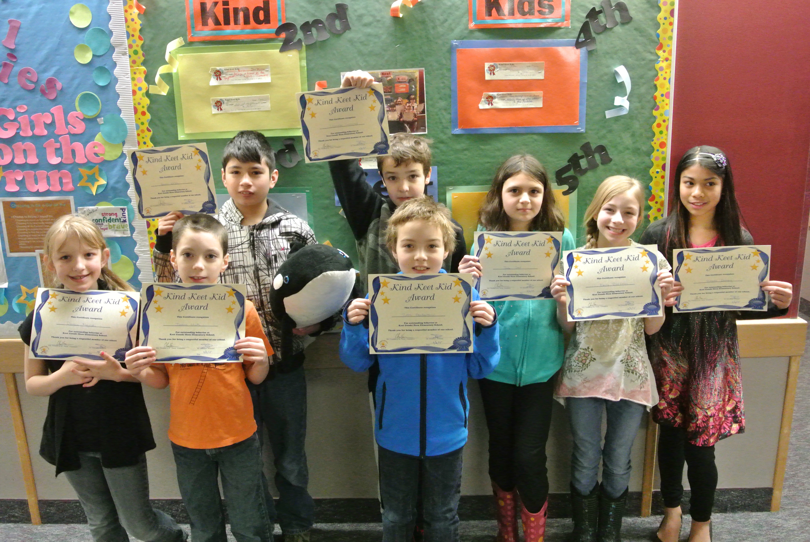
Sitka School District Budget Process Still to Come
4/17/19 @ 6 pm SHS Library: Final Budget Hearing and Final Adoption
FY20 Budget Process Latest News: www.sitkaschools.org

Slide 24
Budget Worksession III
April 12, 2019
DISCOVER | NURTURE | INSPIRE

