Slide 1
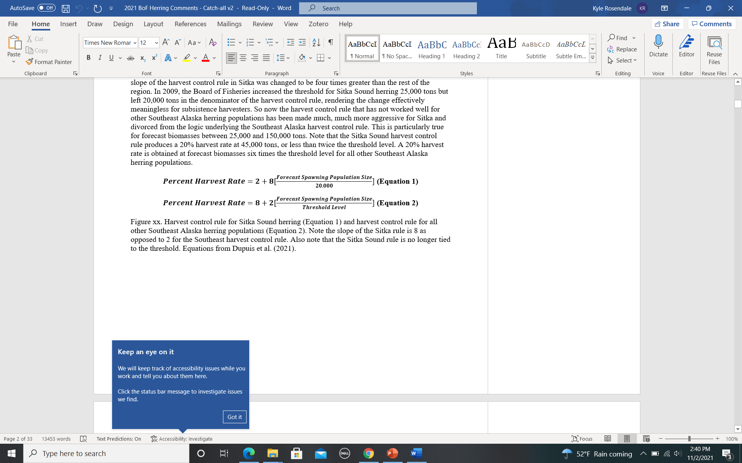
Sitka HCR
SEAK HCR
8
2
Proposal 156
Sitka AC Meeting
11/4/2021
Sitka Tribe of Alaska
Proposal 156

Slide 2
Slope of Sitka Sound HCR is four times greater than SEAK slope
Proposal 156 simple seeks to switch the 2 and 8 back to the SEAK format
The Sitka AC unanimously supported a slightly more conservative version of Proposal 156 prior to 2018 BoF meeting
Note: Sitka Sound HCR no longer tied to threshold
8
2
Proposal 156
Sitka HCR
Sitka AC Meeting
11/4/2021
Sitka Tribe of Alaska
Proposal 156
SEAK HCR

Slide 3
Maximum difference in GHL is 3,600 tons @ 60,000 tons forecast biomass
Sitka AC Meeting
11/4/2021
Sitka Tribe of Alaska
Proposal 156

Slide 4
Comparison of GHLs from Sitka HCR and Proposal 156 using historic forecasts
Based on HCR in regs; does not include years ADFG reduced GHL (e.g. 2013, 2021)
Sitka AC Meeting
11/4/2021
Sitka Tribe of Alaska
Proposal 156

Slide 5
Slope of Sitka Sound HCR is four times greater than SEAK slope
The Sitka AC unanimously supported a slightly more conservative version of Proposal 156 prior to 2018 BoF meeting
Sitka Sound HCR no longer tied to threshold
Implications of threshold and AUB
Issues with biomass as only indicator of population health
Sitka HCR
SEAK HCR
Sitka AC Meeting
11/4/2021
Sitka Tribe of Alaska
Proposal 156
8
2
Proposal 156

Slide 6
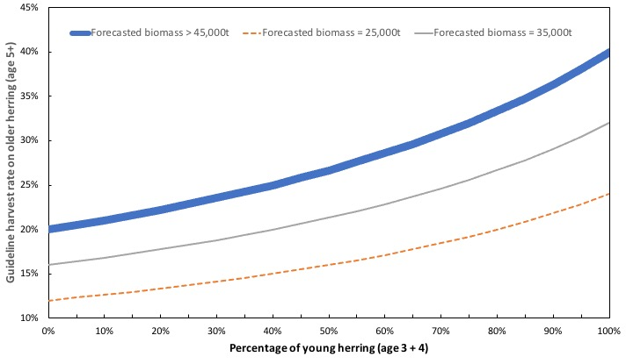
Sac roe fishery harvests older fish at approximately twice the rate as younger fish (based on ADFG data)
In years with lots of younger fish, this can lead to high exploitation rates on older fish
Proposal 157 attempts to limit the harvest rate on old fish to 20%
Sitka AC Meeting
11/4/2021
Sitka Tribe of Alaska
Proposals 157 / 158

Slide 7
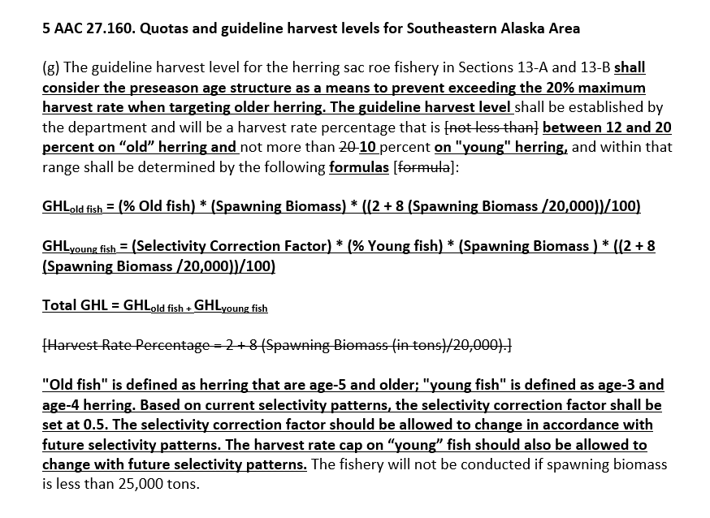
Sitka AC Meeting
11/4/2021
Sitka Tribe of Alaska
Proposals 157 / 158

Slide 8
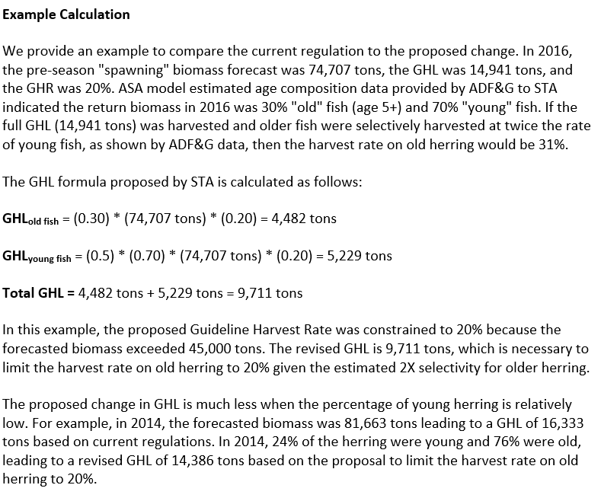
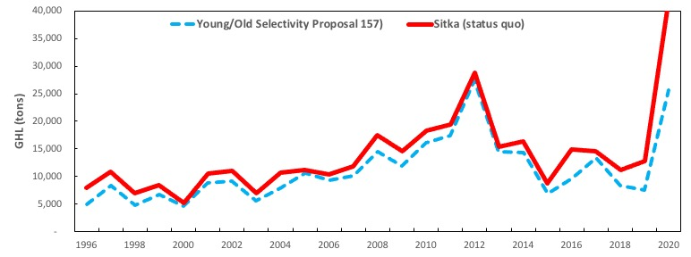
Sitka AC Meeting
11/4/2021
Sitka Tribe of Alaska
Proposals 157 / 158

Slide 9
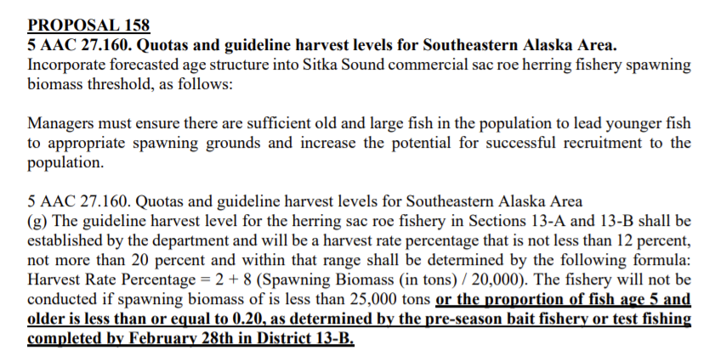
Sitka AC Meeting
11/4/2021
Sitka Tribe of Alaska
Proposals 157 / 158

