Slide 1
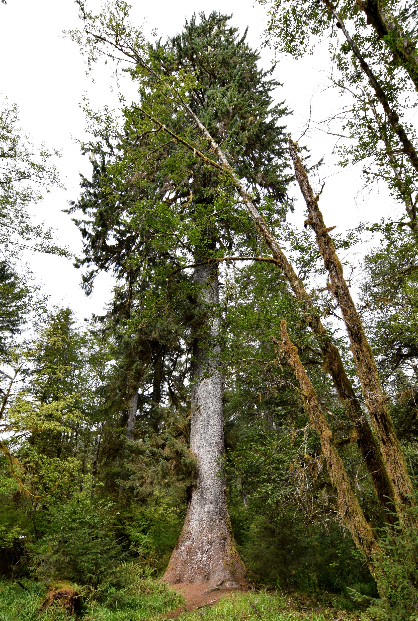
The Alaska Disconnect
The Root of Alaska’s Problems
Rep. Cliff Groh
Cameron Ebersold
Sitka Spruce – our State Tree
Notes:
Hi everybody, thanks for coming. I’m Cliff Groh, and I came from Anchorage with my staff member Cameron Ebersold to talk with you about Alaska’s biggest problem.

Slide 2
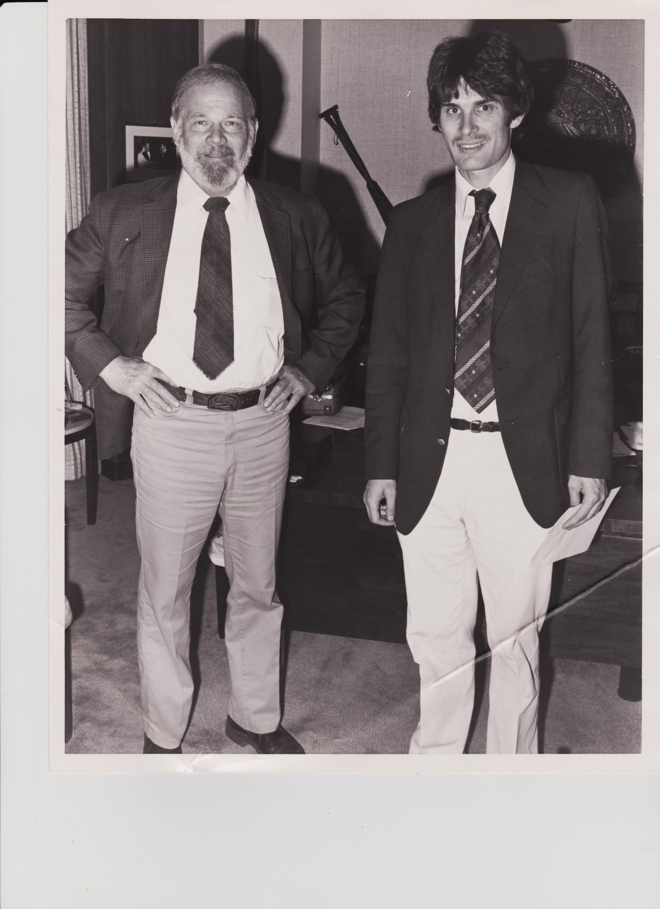
Can you ID the men in this photo?
Me,
Age 28
Who am I?
Lifelong Alaskan born in the Territory
Lived in Anchorage, Sitka, Juneau
One of the creators of the PFD
Studied since the 1980s Alaska’s economy, and the ways the State of Alaska collects, spends and saves
1st term legislator for House District 18 (North Anchorage)
Jay Hammond,
Governor of Alaska
1974-82
June 1982
Juneau AK

Slide 3
Goals for this Presentation
Help you understand the major cause of Alaska’s troubles
Give you some tools to assess proposed solutions yourself
Notes:
This is what I’m trying to do today. Please let me know how I did.

Slide 4
What do you perceive are biggest problems we are currently facing in Alaska?

Slide 5

We have some problems in Alaska
PFD Cuts
Depleting the Permanent Fund
Falling State Revenue
Deficit Budgets
Poorly Maintained Roads
Stagnant Economy
Inadequate K-12 Outcomes
Insufficient Public Safety
Crime
Trouble Retaining Government Workers
Greater Out-migration than In-migration
And Many More..!
Notes:
This shows just a few of the problems we are currently facing in Alaska. It is not comprehensive and there are certainly more, but when Cameron put as many as he could think of, I could no longer read the slide.
This is unsustainable and crummy. These problems are all bad and will get worse if we do not take effective action.
But we spend so much time, money and effort in politics dealing with each of these problems on its own, without

Slide 6

Let’s visualize all these problems as outcomes
Different branches on the same tree
Notes:
Rather than thinking of all these problems as separate, let’s think about them as various branches on a tree

Slide 7
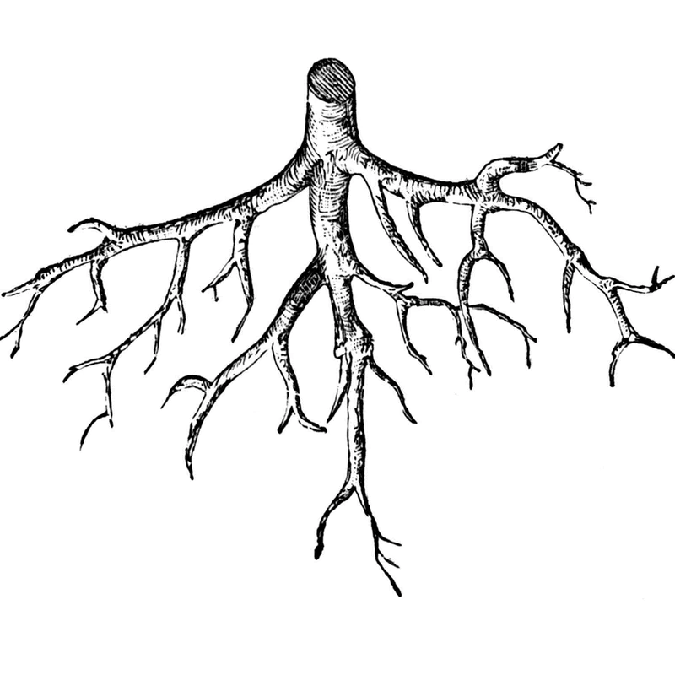
With a common root!

Slide 8
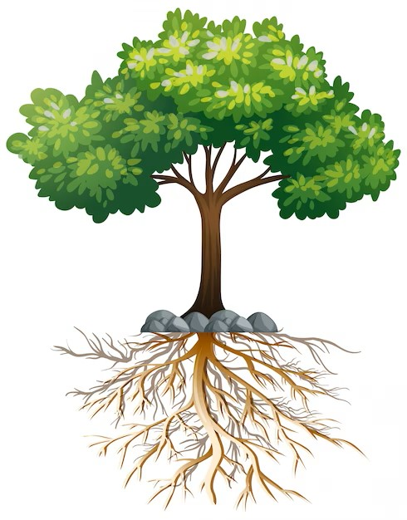
Alaska’s
“Problem Tree”
K-12 Outcomes
SNAP Backlog
Fewer Ferries
Out-migration
Skilled Labor Shortage
Indirect/Broader Consequences
PFD Cuts
Deferred Maintenance Backlog
University Cuts
Direct
Consequences
Road Deterioration
Inadequate Public Safety
Budget Deficits
The Current Problem
Crime
The Alaska Disconnect
The Root Cause
Notes:
The Alaska Disconnect is this common root. It is the upstream problem that leads to our the Budget Deficits Alaska has experienced a lot in the last dozen years, and then to all the problems that come out of that. Note that we had nine straight years of budget deficits from FY13-FY21 totaling more than $13 billion, covered by us blowing through $16 billion in savings in that period.
The outcomes can be thought of in two categories: the direct consequences on the services, and then the indirect consequences which either originate from or are made worse by the direct consequences.
We can spend our time, effort, and money pruning the different branches, i.e. problems, or we can address the root causes of these problems.
The Alaska Disconnect is the root problem.

Slide 9
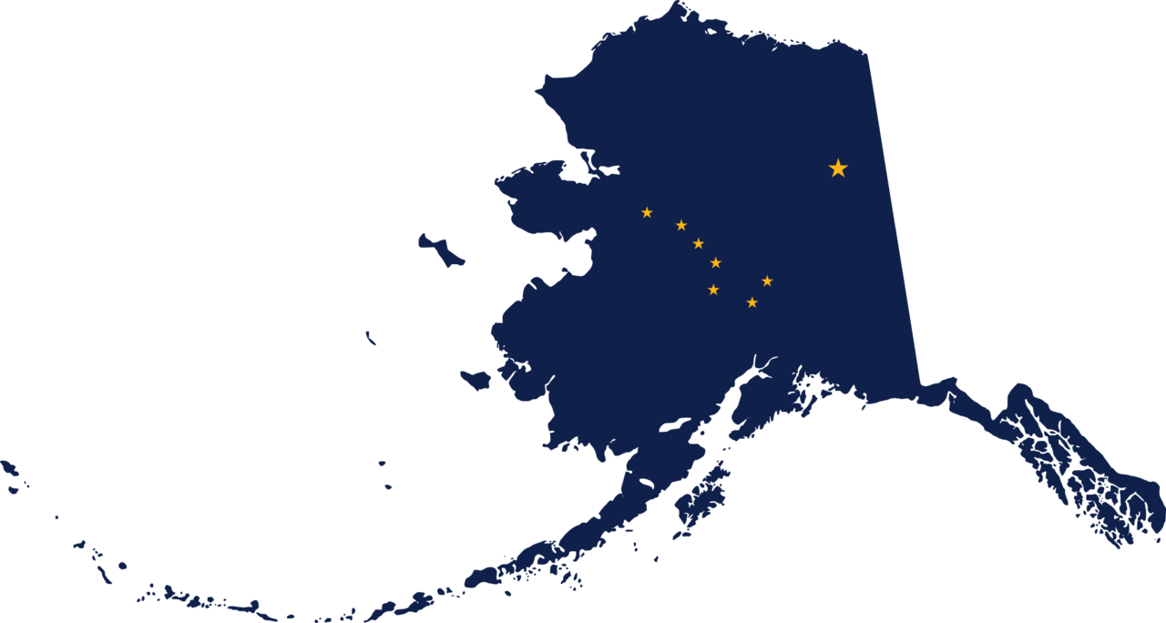
What is
The Alaska Disconnect?
As the population of Alaska increases, the revenue generated by the State of Alaska does not scale proportionally to the state services required by those population increases.

Slide 10
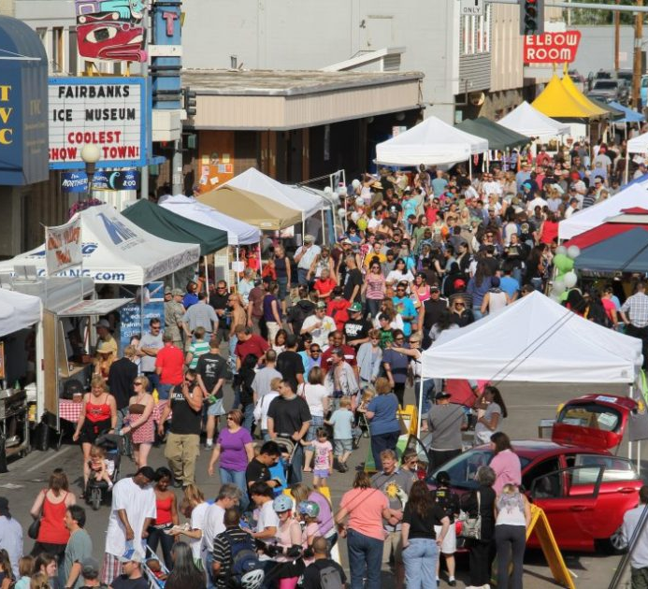
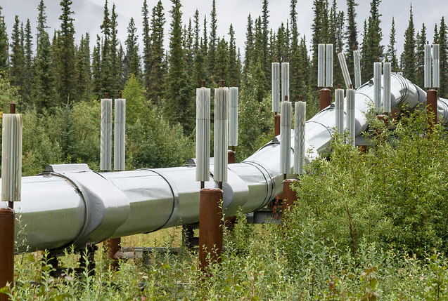

Government Services
K-12 Education
University of Alaska
Permanent Fund Dividend
Road Maintenance
Public Safety
And others!
Social & Economic Effects
Leads to
Alaska’s People
Leads to Demand for
Resource Development
Permanent Fund Earnings
State Revenue
$$$
Does not lead to
Leads to
The Alaska Disconnect
Notes:
This should help demonstrate. The key is that the Alaska Disconnect only worked for Alaska when Alaska kept getting large amounts of new oil money each year. That is not happening now and will never reach the glory days of the late 1080s, when the Trans-Alaska Pipeline System carried more than 2 million barrels each day.

Slide 11
If Alaska’s population were to double…
Government Services
State Revenue
Roads would require more maintenance or degrade in quality
We would need more school facilities and teachers or face worse outcomes
Our PFDs would get smaller
Public health and safety resources (Troopers, firefighters) would be stretched thin
All State services would either require more investment or quality would suffer.
Would be about the same as now.
Notes:
If Alaska’s population were to be double over the next 10 years:
Roads: wear-and-tear on roads would be higher as more people use them, resulting in either higher maintenance costs or poorer upkeep
Schools: as population increases so too does demand for educational services, requiring more teachers, more facilities… or decreased quality – bigger class sizes, worse facilities, and eventually poorer outcomes. So too with the university – which is what eventually sends more young folks out of state to possibly never return.
This is most obvious with the PFD. Everything else constant, as our population increases, the size of the PFD gets smaller.
Which of these two events happen is dependent on the how much revenue is available. So how much revenue would be available? Everything constant, it would be about the same – dependent on the price of oil.
So if the price of oil is low, do we try to raise taxes on oil companies? Businesses of all kinds like stability – and fluxuating tax rates on oil creates a bad climate for investment.
Now, is our population going to double in the next ten years? Maybe not – but this this thought experiment isn’t really about our past. It’s about our *Present* - this is what is currently happening in Alaska.

Slide 12
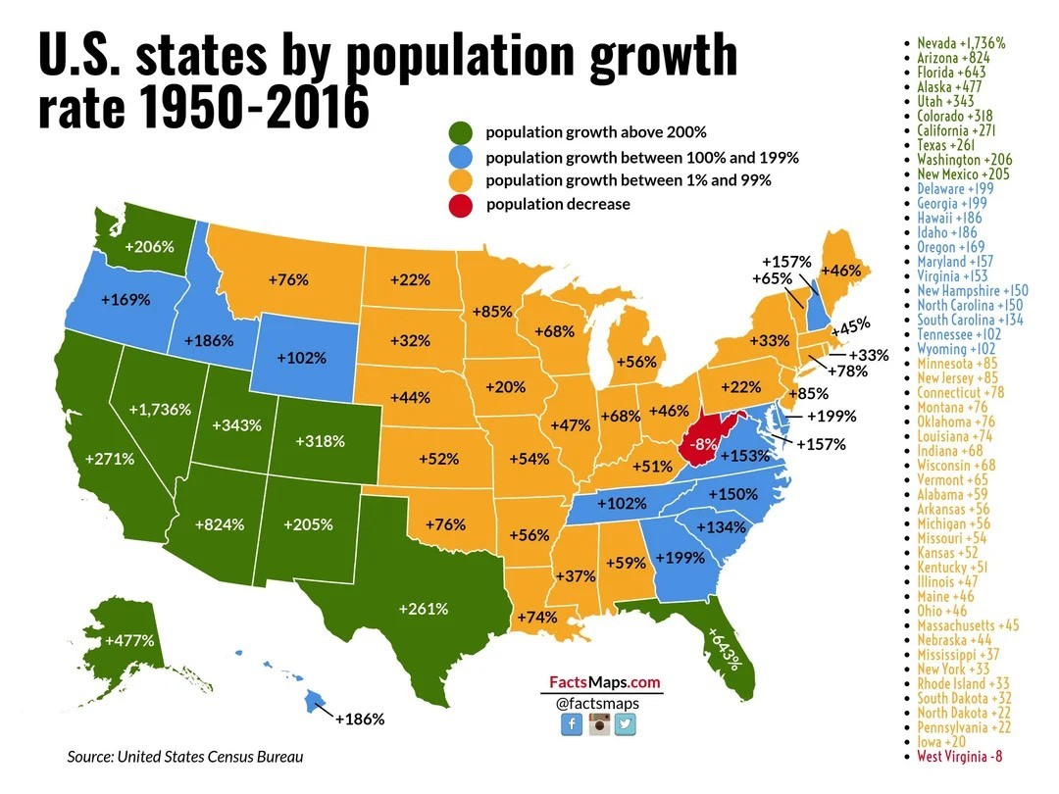
Alaska has grown a lot
Notes:
We’ve experienced extremely rapid growth and in particular in the past 60 and 70 years. The population of Alaska has dropped a little in the last seven years, but less than 1 percent. Alaska’s population has almost tripled since statehood.
The consequences of the disconnect did not become apparent for many years – so long as you’ve got enough oil money – the disconnect doesn’t matter as much.
Low in migration and high out migration are a recent phenomena
Most of that growth happened between the 1960s and 2010s.
Small and changeable
Anyone else here remember the year 1970?
I remember the 1970 census. Alaska’s population was 302 thousand.
I saw a map online recently that recently demonstrated this well. Alaska’s has grown a faster rate than almost anywhere else in the country.
Our growth has flatted off, but many of us aspire to grow in the future. IF that flat continues, it is symbolic of economic stagnation where neither the public or private sectors can benefit from economies of scale and improved quality of life. If we want to grow in the future, we need to be able to invest

Slide 13
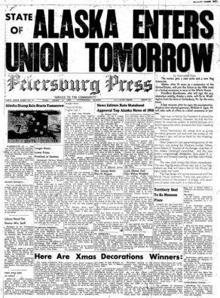
HOW DID
ALASKA
GET HERE?
A Quick Fiscal History
Notes:
To understand where we are now and why we know what we know, we need to
This is not the first time Alaska has had a fiscal troubles

Slide 14
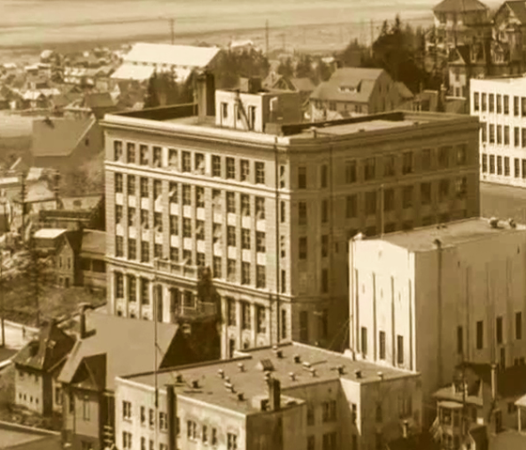
Territorial Problems
The Territory of Alaska experienced years of large deficits.
Territorial finances were dependent on resource extraction taxes (fisheries and mining primarily).
Territory went bust in 1948-1949—the 1947 Legislature approved a budget more than 40% higher than expected revenues.
In 1949, the new Territorial Legislature enacted an income tax.
Notes:
Alaska’s public finances prior to statehood were largely dependent on taxes on resource extraction (fisheries and mining primarily). -- Although Alaska’s population may grow in response to resource extraction, the amount of tax revenue is not related to or commensurate with the population.
Territory of Alaska went bust in 1948-1949—In 1947, the Legislature approved a budget more than 40% higher than the expected revenues.
New Year’s Eve 1948—the Territory owed overdue bills which added up to more than 100 times more than was in the General Fund. University of Alaska only stayed open due to interest-free loans from members of the Board of Regents and “public-minded businesses like Alaska Airlines.”
But, voters wanted change. Territorial residents found they couldn’t provide for their needs just through taxes on resource industries – voters overhauled the legislature and sent reformers to the legislature.
The new legislature enacted a personal income tax back in January of 1949 equal to 10 percent of the amount a resident or non-resident pays in federal income tax on income made in Alaska.

Slide 15
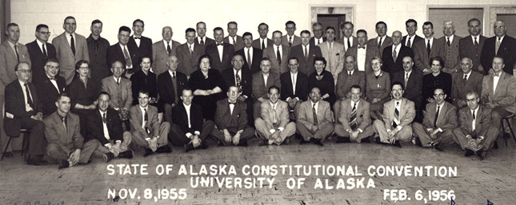
Stability into Statehood
By the early 1950s, deficits became surpluses in the General Fund.
This fiscal stability was a key argument in favor of statehood
Notes:
“By the early 1950s, the Territory that had had large deficits just years earlier was boasting a surplus in its General Fund.”
This fiscal stability was a key argument in favor of statehood, so in many ways the income tax helped the Territory of Alaska become the State of Alaska.
Not all residents of the territory wanted statehood – they regarded statehood as potential source of burdensome government and taxation, and those residents were supported by corporate interests in the Lower 48, as statehood diminished their influence over resource management
And just to check my own bias here: I am partial to the statehood movement – my father was the President of “Operation Statehood”
Not to spoil the story, but the statehood movement is successful: Alaska becomes the 49th US state
And for the first few years of statehood, our fiscal history is unremarkable. While Alaska had a personal income tax in place, the tax supplied up to 25 percent of the General Fund revenues depending on the year. Alaska’s income tax brought in about 40 percent of Alaska’s total tax revenues in the 1950s and 1960s

Slide 16
Hello Oil, Goodbye Income Tax
1980 - Amid the big flush of oil money, politicians convened for a special session and repealed the income tax — establishing the disconnect
Gov. Jay Hammond later calls his decision not to veto the legislation his biggest regret of eight years in office
Prudhoe Bay Oil Lease Sale
TAPS Completed
Income Tax Eliminated
Real per capita UGF Revenue
Notes:
1980 - Amid the craze of the first big flush of oil money, politicians convened for a special session and repealed the income tax — establishing the disconnect
When the income tax was eliminated, the link between Alaska’s state revenue and its population was severed, which is the underlying problem that drives our fiscal imbalance. The State of Alaska’s repeal of the personal income tax makes our state the only one in the country without any form of a broad-based tax. (New Hampshire is the only state without a personal income tax that taxes wages and salaries or a statewide general sales tax, but New Hampshire has a statewide property tax and a personal income tax that taxes interest and dividends.)
Gov. Jay Hammond later calls his decision not to veto the legislation his biggest regret of eight years in office

Slide 17
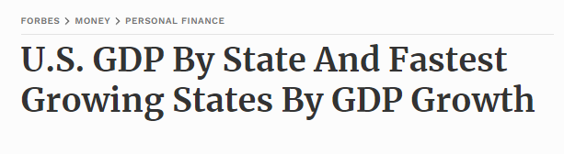
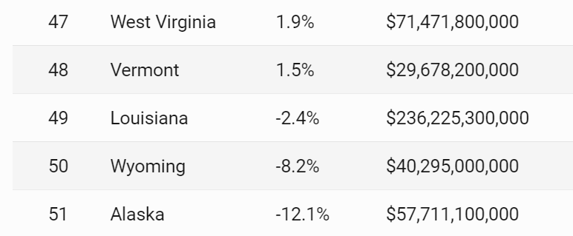
Alaska is the only U.S. State without broad-based revenue
45 states have a state sales tax
41 states have a statewide income tax
40 states have a combination of both*
*New Hampshire doesn’t have personal income tax that taxes wages and salaries or a statewide general sales tax, but has a statewide property tax and a tax on interest and dividends
Notes:
And there are real consequences.

Slide 18

Do you think it is good for people to get government for free?
A Big Question to Consider:
Why or why not?
Notes:
What do you currently pay for government in Alaska?

Slide 19
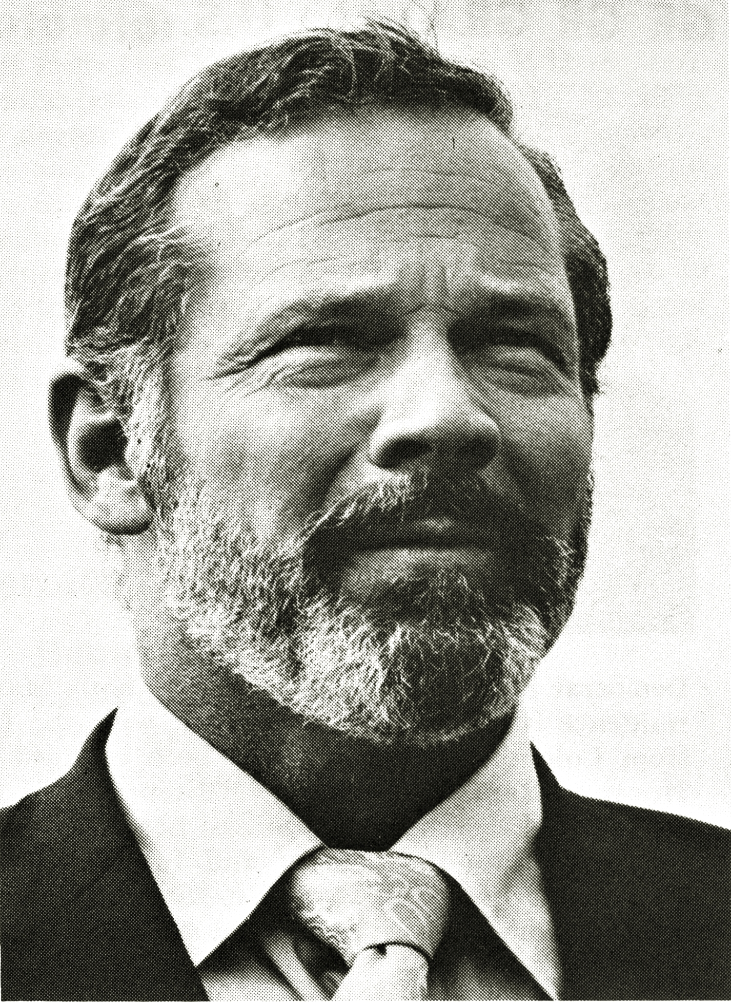
[We] severed the major constraint on spending: the cord that attaches the public’s purse to the fingers of politicians.
– Governor Jay Hammond
Notes:
Governor Hammond certainly did not think it was good for people to get government for free – because when people have to pay, they pay attention.
He recognized that taxes are one of the greatest constraints on spending – because politicians have to face the public and justify how they are spending your tax dollars.
There seems to be major concern that if there was broad based revenue in Alaska, the government will spend like crazy, but in fact it’s the opposite
This pressure to keep taxes low keeps pressure on politicians to invest dollars wisely.

Slide 20
Data Sources:
Government Spending and population data from Alaska Legislative Finance Division
Inflation adjustments made using Urban Alaska CPI data from the Bureau of Labor Statistics
AK Personal Income Data from the Bureau of Economic Analysis
Notes:
It seems Governor Hammond was correct: During the days of the income tax, Alaska’s government was smaller.

Slide 21

Questions
Who benefits from the Alaska Disconnect?
Who currently pays to keep the disconnect going?
Who will pay for a solution?
Who will benefit from a solution?

Slide 22
Solutions
What kind of Alaska are we heading towards?
What kind of Alaska do we want in the future?
Notes:
If you care about one of the issues, you care about fixing the disconnect

Slide 23
