Slide 1

Sitka Strategic Plan
2023 Progress Report
Community Town Hall | December 2023

Slide 2
AGENDA TOPICS
  Strategic Plan Overview
  Year 1 Progress Updates
  Next Steps
  Community Input

Slide 3
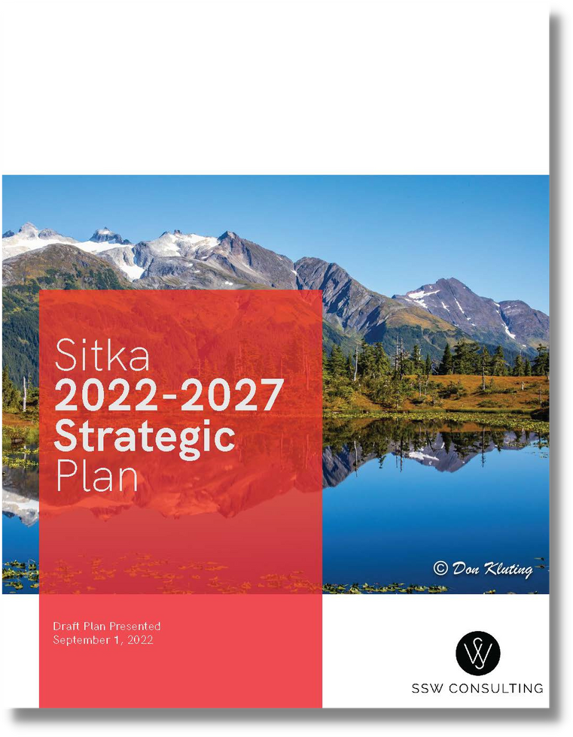
STRATEGIC PLAN OVERVIEW
Notes:
Pulling from the long-range Comprehensive Plan that was a 2.5 year process that produced broad community goals and overall direction that looks far into the future, this plan is a shorter (five year) plan focused on guiding and improving the delivery of CBS services that also include the extensive community outreach from the Comprehensive Plan that was a 2.5 year process that produced broad community goals and overall direction that looks far into the future.
A strategic plan gives staff defined goals and actions
It drives vision and aligns the organization’s mission and values which brings our vast departments in one direction
It provides an action plan and means to measure
It cultivates ongoing planning, monitoring, analysis and assessment of the goals and objectives

Slide 4

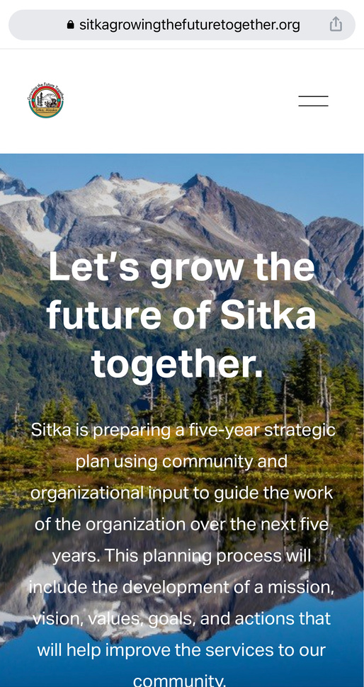
BACKGROUND
  The strategic plan is the first plan developed for CBS, it was adopted in September 2022
  The goals were developed with extensive public outreach including:
    About 700 survey responses
    Social Media
    Focus Groups
    Community Leader Interviews
    Staff Survey
    Website
    Fact Sheet
    Boards, Commissions, + Community Group Presentations
    Utility Bill Mailer
    Media Releases
Notes:
First plan for the CBS which was adopted in September 2022 / approved by the assembly / to be reviewed each year and kept as a live document.
The process began in March of 2022, the assembly and city leadership team participated in a workshop to share ideas and how to engage the community and organization in the process.
Public outreach included:
There was a big push for an online and paper survey from the community
Consistent social media posts about the plan and survey
There were focus groups where special interest groups could schedule interviews with the consultants
Staff sent emails to every community leader they could think of for interviews
A staff survey was given with a high participation rate
This was posted on the city’s website front and center
Fact sheets where distributed and posted that told what a strategic plan is and how to get involved
Staff went to the boards and commissions where they presented and asked for feedback
Information went out in the utility bills
And the media helped get the word out

Slide 5







CITY AND BOROUGH OF SITKA (CBS) STRATEGIC PLAN
GOALS
MISSION
Provide public services for Sitka that support a livable community for all
VISION
CBS is an organization that values everyone and proactively works together to serve the community. We are fiscally sustainable, supporting a diverse economy and well-managed infrastructure. We are innovative in seeking ways to protect and preserve Sitka’s natural environment. We are a respected employer where people enjoy their work and provide valued public services.
COMMUNICATION
Improve communications and strengthen relationships within the community and organization
QUALITY OF LIFE
SUSTAINABLE
Preserve the quality of life and affordability for all Sitkans
Align resources and financial and economic policies with CBS' goals for a sustainable community
VALUES
PEOPLE
INTEGRITY
SERVICE
INNOVATION
SUSTAINABLE
INFRASTRUCTURE
SERVICE
Plan and invest in sustainable infrastructure for future generations
CBS is recognized as being a great place to work and excellent service provider to the community

Slide 6
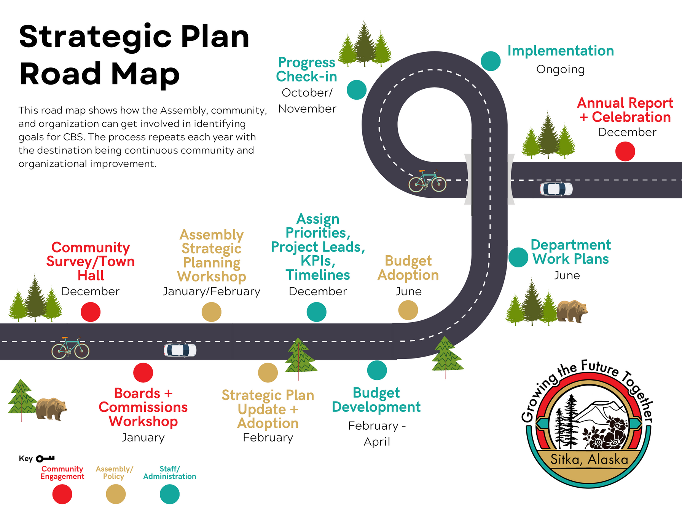

Slide 7

GOAL 1: Preserve the quality of life and affordability for all Sitkans.
1.1 Convene community partners to develop a community-wide strategy to improve access to childcare
1.2 Develop a plan to improve housing options for all in Sitka
1.3 Identify opportunities to relieve the burden of utility costs
1.4 Review the impacts and benefits of tourism, and develop policies that prioritize the quality of life for all Sitkans
1.5 Convene community partners to develop an action plan that will address the challenges of food security
Started + Ongoing
Started + Ongoing
Started + Ongoing
Started + Ongoing
Started + Ongoing

Slide 8
GOAL 2: Improve communications and strengthen relationships within the community and organization
2.1 Develop a communication and engagement plan to increase engagement and participation through storytelling and enhancing Sitka's communication tools and networks
2.2 Identify opportunities to foster relationships with underrepresented groups/populations in the community and implement findings to improve service delivery to these groups
2.3 Annually convene non-profits, city boards and commissions, and other community groups for a community summit to discuss community challenges, updates, and opportunities for collaboration
Started + Ongoing
Started + Ongoing
Not Started
Year 2-5

Slide 9
GOAL 3: Align resources and financial and economic policies for a sustainable community
3.1 Develop a fiscal policy that includes guidelines for areas of fiscal operations such as debt management, infrastructure replacement, metrics for fiscal health of funds, reserves, and other areas.
3.2 Prepare financial forecasts and life cycle models for all assets to bring resources in alignment with the City’s top priority needs.
3.3 Convene economic partners to explore the addition of business support services and employment training programs.
3.4 Identify and implement policies that will balance the economic benefits of tourism with the impacts on Sitkan's quality of life
Started + Ongoing
Started + Ongoing
Not Started
Yr 2-5
Started + Ongoing

Slide 10
GOAL 4: Plan and invest in sustainable infrastructure for future generations
4.1 Identify and pursue funding to address existing capital needs and deferred maintenance
4.2 Develop asset management plans for future capital investments
4.3 Identify the levels of service for CBS's infrastructure and identify the resources needed to support these levels
4.4 Collaborate with public land management agencies and stakeholders to maintain and develop sustainable active transportation infrastructure, including parks, fields, cabins, trails, and water access
Started + Ongoing
Started + Ongoing
Started + Ongoing
Started + Ongoing

Slide 11
GOAL 5: CBS is recognized as being a great place to work and excellent service provider to the community
5.1 Develop a workforce development plan that outlines clear policies for staff training and professional development
5.2 Prepare a succession plan that addresses development of the current workforce and future workforce recruitment and retention strategies
5.3 Improve customer service levels and evaluate process improvements for service delivery
5.4 Identify and develop necessary standard policies and procedures to promote organization-wide stability and service-level consistency
5.5 Develop an internal communication and engagement plan and policies to improve the flow of information in the organization and increase employee engagement
Started + Ongoing
Started + Ongoing
Started + Ongoing
Started + Ongoing
Started + Ongoing

Slide 12
YEAR 1 PROGRESS HIGHLIGHTS
Notes:
A highlight from Goal #1 is the Pathways Summit that city staff convened in the fall of 2023 with educators and the childcare industries, along with the childcare now and early childhood groups.
The group is moving forward to find ways for high school students to earn the necessary certifications in order to work in the industry by the time they graduate.
A highlight from Goal #2: Open finance available on the city’s website that shows citizens how their tax dollars are being used and to engage the public in the budget process.
Also includes Balancing Act, a budget simulation tool for spending and revenue that allows for public input to be considered into the next FY budget.
Tax Payer’s Receipt, real time data on where YOUR money is going.
Goal #3: The Assembly formed a Tourism Taskforce to meet 3.4. P&CD director is an ex-officio member.
Goal #4: Multiple grants have been secured:
Seawall
Safe Streets for All – to secure funding for road down the line
Haul Out lift for $1million
Hydro: 242 which is $2million in incentives
$134,000 for Crescent Harbor High Load Dock Net Shed project
SeaWalk
Sea Plane Base
Airport
LWCF crescent Harbor Park Courts Rehab (waiting to hear about)
CTP – Katlian Street (waiting to hear about)
DOE Section 247 (waiting to hear about)
Goal #5: Administrative policy for sign-on bonus and Employment referral bonus.

Slide 13
HIGHLIGHTS
GOAL 1: Preserve the quality of life and affordability for all Sitkans.
  Weekly childcare meetings with Pathways Summit to collaborate on solutions
  Assembly funded a housing land study to identify best development opportunities for affordable housing
  City teams worked to develop long-term vision for capital improvements, replacements, repairs, + refurbishments)
  Assembly formed the Tourism Task Force in April 2023 to review impacts + benefits of tourism. (These conversations are ongoing.)
  Community engagement around Lincoln Street closures
  City teams addressed food insecurity with the Library “seed library,” and educational gardening courses + participated in development review for community garden plans this past summer.

Slide 14
HIGHLIGHTS
GOAL 2: Improve communications and strengthen relationships within the community and organization
  Increased social media engagement. Messaging included: Hiring/vacanacies, staff kudos, collaboration + partnership with other agencies
  Open Finance launched online - live City spending available to public
  Balancing Act budget simulation tool available online for Sitkans
  Tax Payers Receipt live online to showcase dollars spent based on approved budget
  Community engagement to help residents better understand utility bill system via the Community Renewable Energy Strategy
  Parks + Rec program offers additonal services like open gyms, facility rentals, summer programming + more

Slide 15
HIGHLIGHTS
GOAL 3: Align resources and financial and economic policies for a sustainable community
  Harbor Rate Study is underway (currently being scoped)
  Harrigan Center Hall - A.V. maintenance
  Building condition assessments (including all CBS-owned school buildings) have been initiated to enhance capital improvement planning for the Building Maintenance Division
  The Assembly formed the Tourism Task Force in April 2023
  Administration established a new annual process for the public to submit project proposals using CPV funds when there is a surplus of CPV funding available
  Department of Energy Section 242 incentive program qualified for an incentive payment.
  Department of Health, Healthy & Equitable Communities funding of $133,774 for the Crescent Harbor High Load Dock net Shed project.

Slide 16
HIGHLIGHTS
GOAL 4: Plan and invest in sustainable infrastructure for future generations
  Secured Safe Streets for All Action Plan to identify safety hazards, maintenance needs, and active transportation improvements
  Applied for and received $2M for Blue Lake’s hydro production
  Applied for $2.5M (30%) of Green Lake Phases II and III
  CBS applied for $9.5M to fund critical projects that were identified as legislative priorities and high risk areas of the grid. We also were awarded the 242 for our clean energy production
  Denali Commission Program grant submittal and award for $1 million to purchase a haul out lift for the Gary Paxton Industrial Park Haul Out project- funding will be available January 2024.
  Department of Energy Section 247 incentive program for Phase II and III of the Green Lake Rehabilitation project for $3.3 million.
  Department of Energy Section 242 incentive program qualified for an incentive payment
  Department of Health, Healthy & Equitable Communities funding of $133,774 for the Crescent Harbor High Load Dock net Shed project
Notes:
Huzzah! (fun fact, Sitka was one of only 9 communities of the 60 recipients to receive the full $1M per year

Slide 17
HIGHLIGHTS: GOAL 4 PART 2
GOAL 4: Plan and invest in sustainable infrastructure for future generations
  Community Transportation Program (CTP) grant to support the Katlian Avenue Paving and Improvements project.
  Rural and Tribal Assistance Pilot Program grant for $150,000 to fund a condition assessment for two CBS-owned bridges: Granite Creek Landfill Bridge and Sawmill Creek Powerplant Access Bridge.
  CBS developed and implemented an unanticipated event capital fund in FY24. A shorter capital emergency response time is expected for future unanticipated events.
  The Public Works Department has a nearly fully staffed Engineering Division to help manage the many capital projects that are underway. Working on projects that have been in the deferred status for some time. Having these staff available to work on concept and design planning improves CBS’s eligibility for grant funding
Notes:
Huzzah! (fun fact, Sitka was one of only 9 communities of the 60 recipients to receive the full $1M per year

Slide 18
HIGHLIGHTS: GOAL 4 PART 3
GOAL 4: Plan and invest in sustainable infrastructure for future generations
  Planning for the development of a Park and Recreation Asset Management plan
  Developed thorough asset inventories for all Public Works Assets
  Added signage to further identify the location of the Sitka History Museum in Harrigan Centennial Hall. Upgraded theater lighting and to bring the HCH auditorium lighting up to current configurations.
  A $1 million federal grant was awarded for the Sitka Community Renewable Energy Strategy to identify the community’s desired level of service with regards to reducing carbon-based energy usage and electrification
  Acquired and installed a geographically diverse data center backup system as part of our disaster recovery plans.

Slide 19
HIGHLIGHTS: GOAL 4 PART 4
GOAL 4: Plan and invest in sustainable infrastructure for future generations
  CBS has partnered with Western Federal Lands and Alaska Department of Transportation to develop Phase II of the Sitka Sea Walk – Construction anticipated in fall of 2024
  CBS and Sitka Tribe of Alaska are coordinating and collaborating on the development of the Rocky Gutierrez Airport Terminal Improvements Project and Sea Plane Base Relocation and Improvements Project.
  CBS is actively coordinating with the GPIP Board and the Assembly to develop the GPIP Haulout Project
  CBS received grant funding through MIRAD for the Marine Service Center Sea Wall Replacement Project
  The Crescent Harbor High-Load Dock/Net Shed Refurbishment Project is moving forward and anticipated to begin construction in 2024
  CBS is moving forward reviewing construction options for the Crecent Harbor Restroom Replacement Project

Slide 20
HIGHLIGHTS
GOAL 5: CBS is recognized as being a great place to work and excellent service provider to the community
  Public Works developed a new safety program to creating a safer working environment for all employees
  Public Works developed a Snow and Ice Management Policy to drive a better level of service to the community
  New administrative policies to help improve recruitment
  Implemented an HRIS system that combines payroll, benefits, time & attendance, and core HR for efficiency.
  Adopted early voting as another form of absentee voting
  Process improvement initiatives in Public Works and Library to improve services to the community
  Conducted an Employee Climate Survey
  An internal portal launched in 2023 that directs staff to a landing page that includes News within the organization, a workspace to share documents, policies, and procedures.

Slide 21
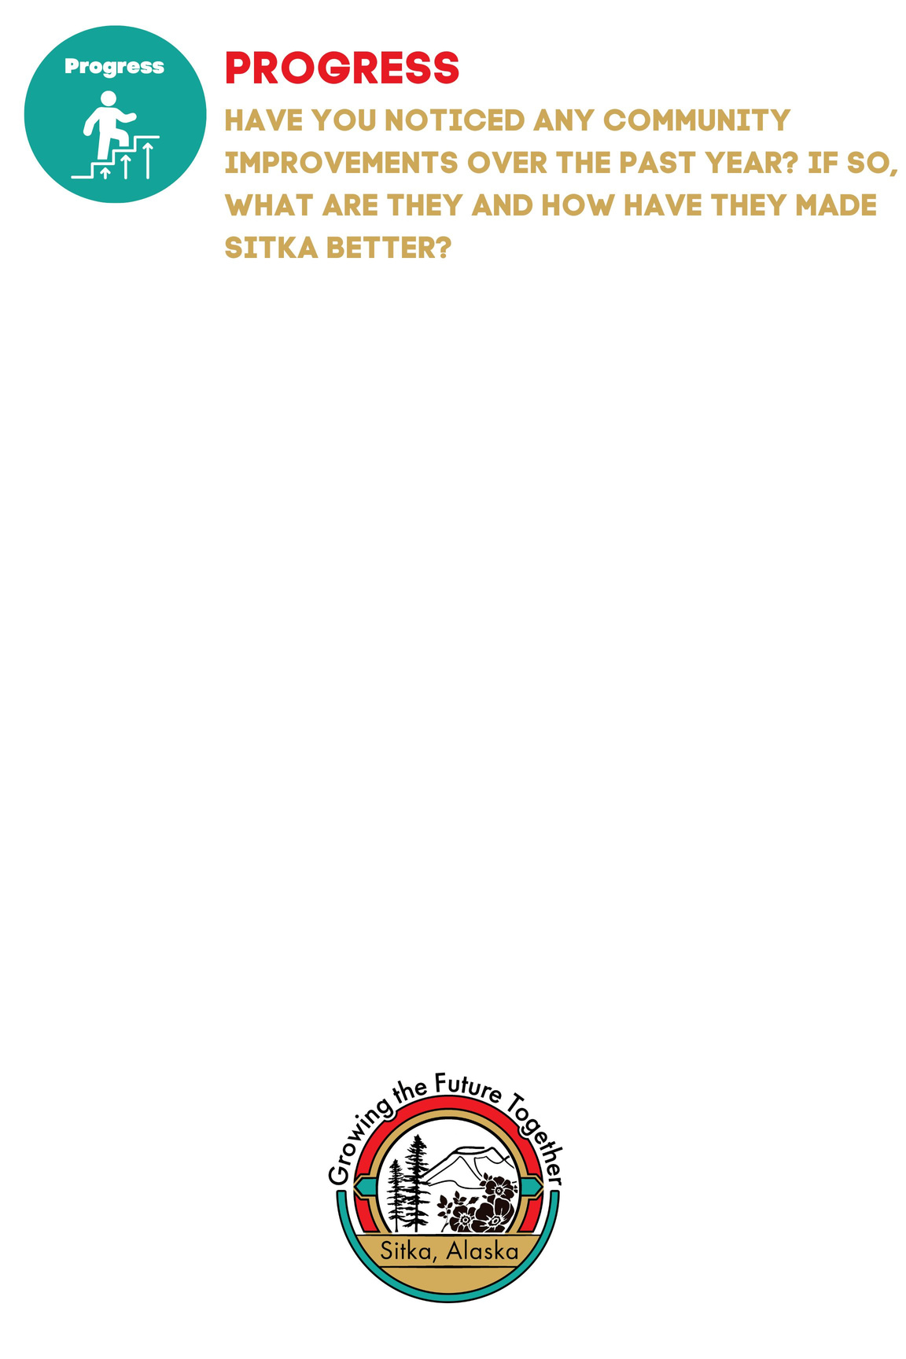


COMMUNITY QUESTIONS
Notes:
This is where we could direct the audience to write on the posters.

Slide 22
NEXT STEPS
  Assembly retreat in January
  Refinement or Updates to the Strategic Plan
  Continued implementation of the Strategic Plan

Slide 23
QUESTIONS + DISCUSSION
THANK YOU!

